Slide 1
Computational Thinking
The Heart of Computer Science

Slide 2
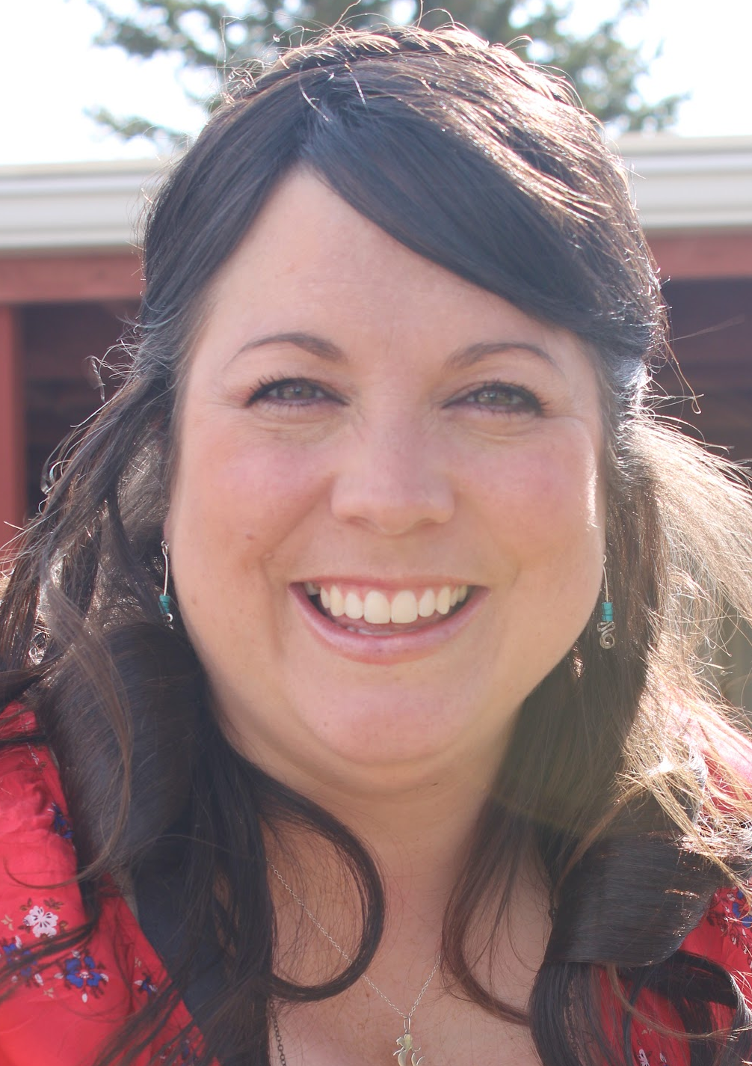
Hello!
I am Mrs. Tyser, or Ms. Ty for short.
I am not a computer.
But I can think like a computer.
Computational thinking is solving problems using the power of computers.
Also, I am MAGNIFICENT...

Slide 3
Ms. Ty the Magnificent
First,
Think of any number between 1 and 10 (including 1 and 10).
Second,
Double your number.
Third,
Add 2 to the result.
Fourth,
Take half of the sum.
Fifth,
Subtract your original number.

Slide 4
1
Your answer is ONE!
Ms. Ty is magnificent!

Slide 5
How does she do that?

Slide 6
Objective
At the end of this lesson, you will be able to:
Define decomposition, abstraction, pattern recognition, and testing and debugging;
Create an unplugged algorithm; and
Use Scratch to program your unplugged algorithm.
Wyoming Computer science standards addressed:
8.AP.A.01 - Create flowcharts and pseudocode to design algorithms to solve complex problems.
8.AP.M.01 - Using grade appropriate content and complexity, decompose problems and sub-problems into parts to facilitate the design, implementation, and review of programs.
8.AP.M.02 - Using grade appropriate content and complexity, create procedures with parameters to organize code and make it easier to reuse.
8.AP.PD.03 - Systematically test and refine programs using a range of test cases.
8.AP.PD.04 - Using grade appropriate content and complexity, document programs in order to make them easier to follow, test, and debug.

Slide 7
Pretest
What does decomposition in computer science mean?
How does a computer scientist use abstraction?
Why is pattern recognition important to creating algorithms?

Slide 8
Computer Science Talk...
We will use and understand these words in this lesson:
Decomposition - breaking a large program into smaller parts
Abstraction - pulling out the important information
Algorithm - a list of steps to finish a task
Bug - an error in software code
Debugging - finding and fixing errors in code
Patterns - things that repeat (in code we look for things we can use over and over)

Slide 9
Ms. Ty the Magnificent
First,
Think of any number between 1 and 10 (including 1 and 10).
Second,
Double your number.
Third,
Add 8 to the result.
Fourth,
Take half of the sum.
Fifth,
Subtract your original number.

Slide 10
4
Your answer is FOUR!
Ms. Ty is magnificent!

Slide 11
Your Challenge:
Create a program in Scratch Jr. that will perform this magic trick on anyone.

Slide 12
This is a big problem. Let’s break it down into smaller parts. That’s called
DECOMPOSITION.

Slide 13
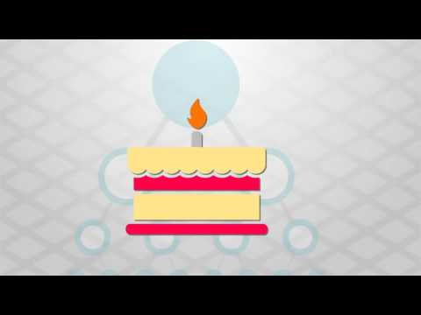

Slide 14
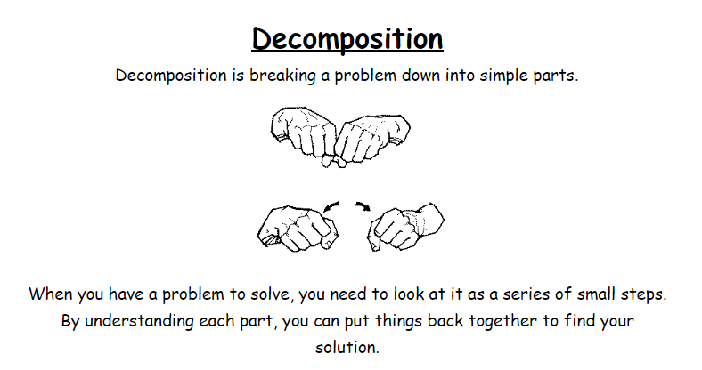

Slide 15
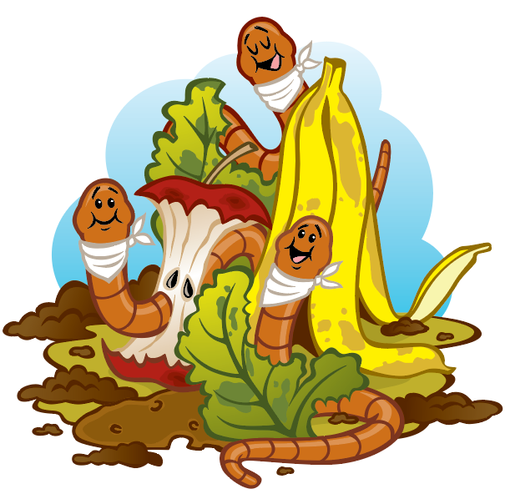
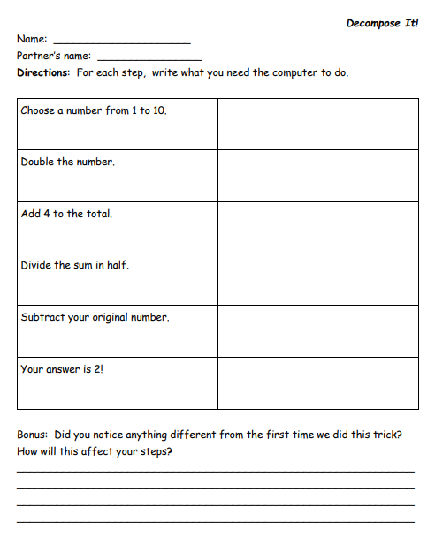
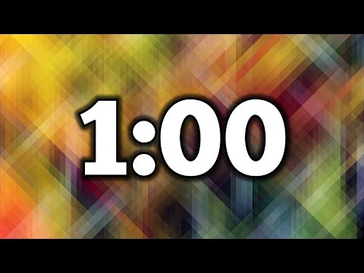
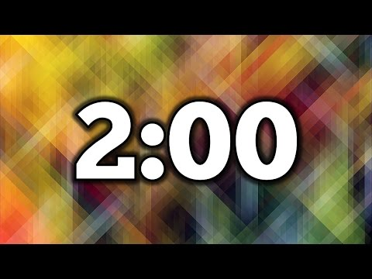
Let’s DECOMPOSE...
YOUR JOB...
Using the organizer, write what you need the computer to do for each step of the magic trick.
Work on this by yourself for one minute, then we’ll work with a partner for two minutes.
After that, we’ll go through it as a class.

Slide 16
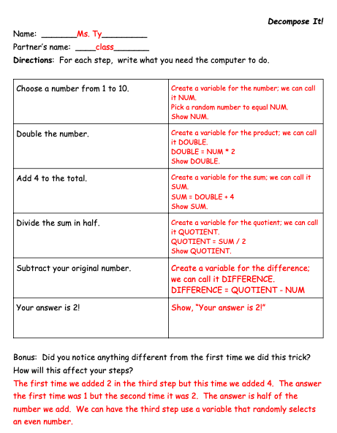
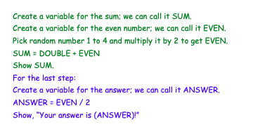
When we write down steps for a computer in the right order using human language we call it PSEUDOCODE.
We can use pseudocode to guide our programming.

Slide 17
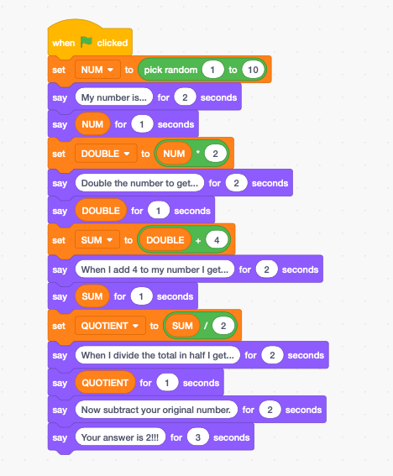

If we used our decomposition to create this program in Scratch, our code and our program might look like this.

Slide 18
Right now, the computer is just doing the magic trick on itself. That’s no fun! We need to pull apart the important pieces the computer will do and which pieces the user will do. This is called
ABSTRACTION.

Slide 19
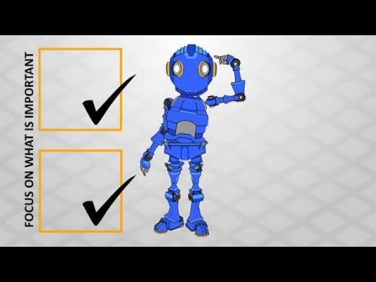

Slide 20
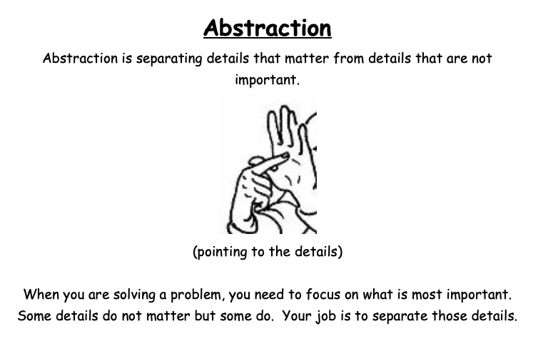

Slide 21
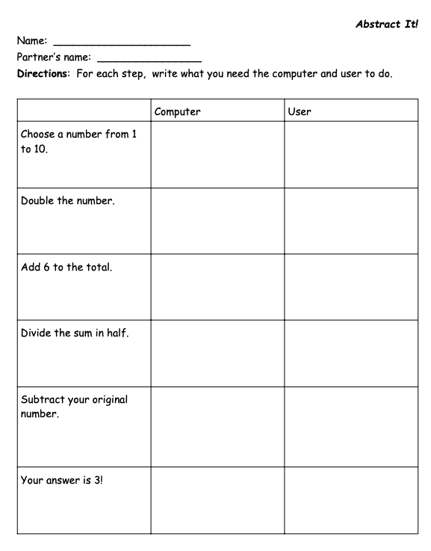
Let’s use ABSTRACTION...
YOUR JOB...
Using the organizer, write what the computer will do as the magician and what the volunteer will do.
Work on this by yourself for one minute, then we’ll work with a partner for two minutes.
After that, we’ll go through it as a class.

Slide 22
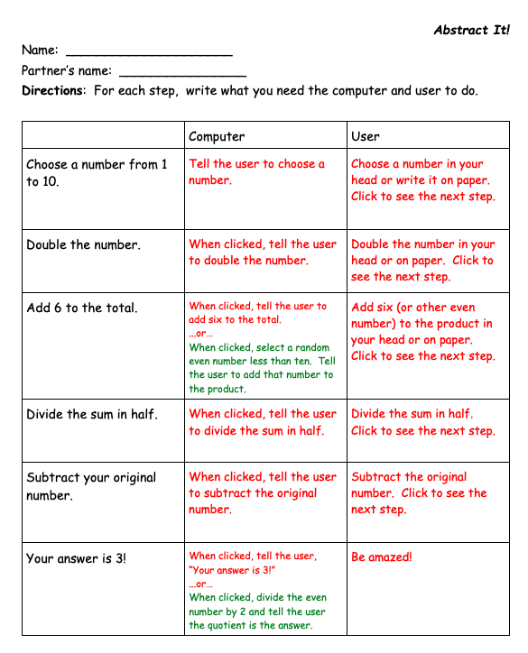

Slide 23
Now we have a direction, we can begin to create our steps in our code. This is called an
ALGORITHM.

Slide 24
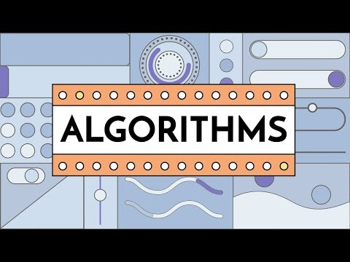

Slide 25
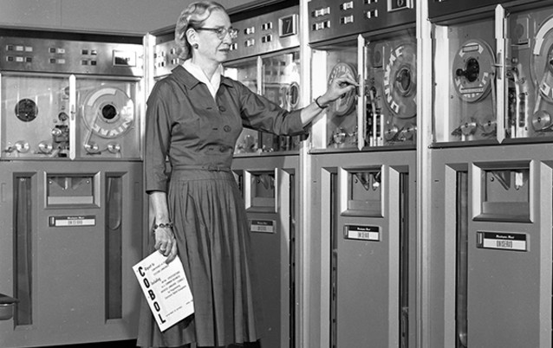
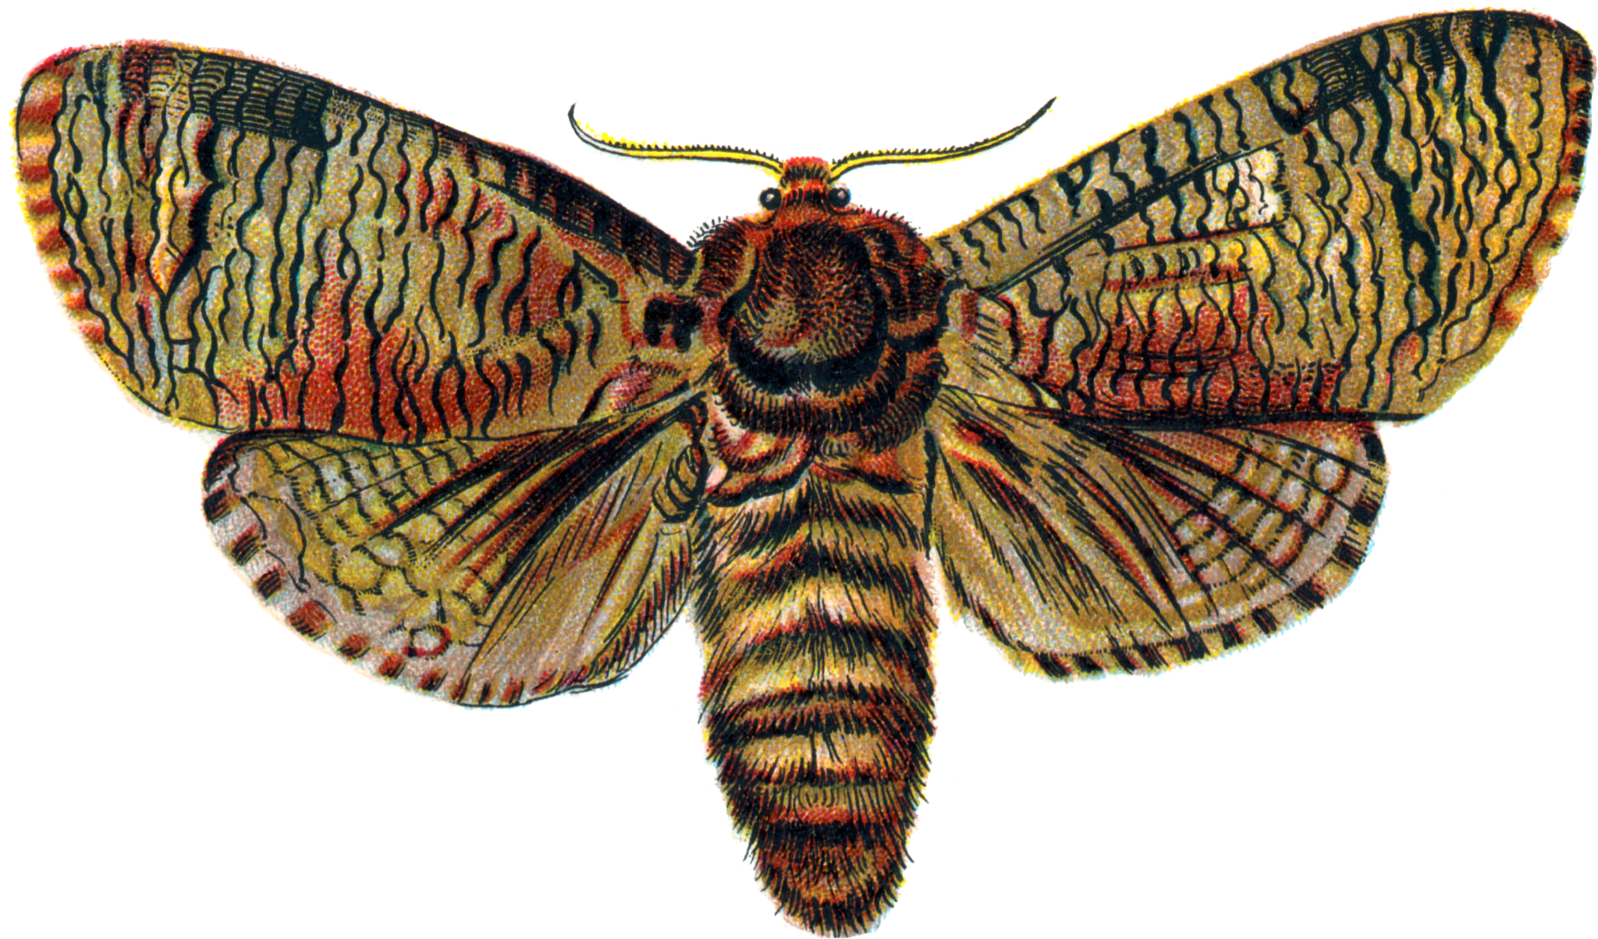
No algorithm is perfect the first time. Computer scientists are constantly testing their algorithms after each step. They look for mistakes, called BUGS, and they fix these mistakes, known as DEBUGGING
I guess I need to DEBUG this program!
Fun Fact:
Pioneering computer scientist Grace Hopper was the first to use the term BUG when a moth flew into her computer.

Slide 26
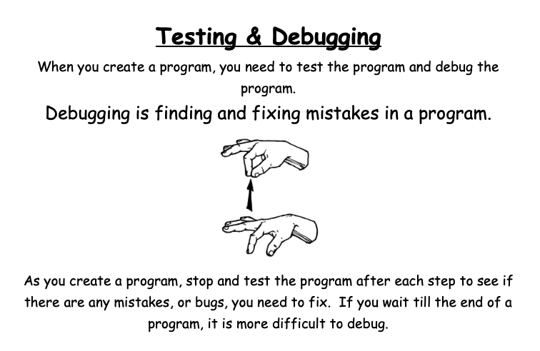

Slide 27

Now let’s create our Algorithm.
Use the information you abstracted to create a magician in Scratch.

Slide 28
If you’re having trouble creating your program, here’s an idea...

Slide 29
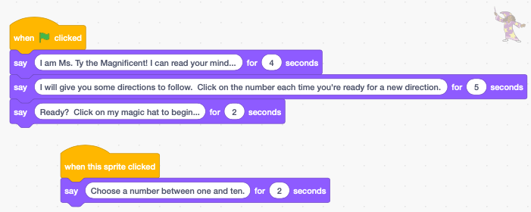
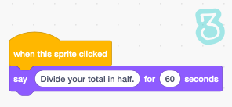
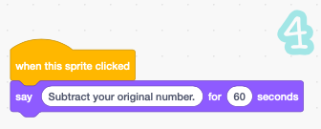
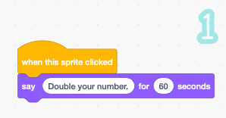
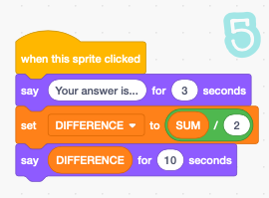
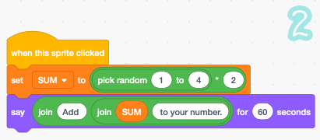
Sample code...
When you look at the code, where do you need to use variables?
How many different algorithms do you need?
Can this program be done with just one algorithm?
Do you need to debug this code?
Can you break the algorithm or will it always work?

Slide 30
How did YOU DO IT?
Share your algorithms.
What patterns do you see?

Slide 31
Things that repeat in a program or from program to program can help simplify the process of creating algorithms and code. We call these parts that repeat
PATTERN RECOGNITION.

Slide 32
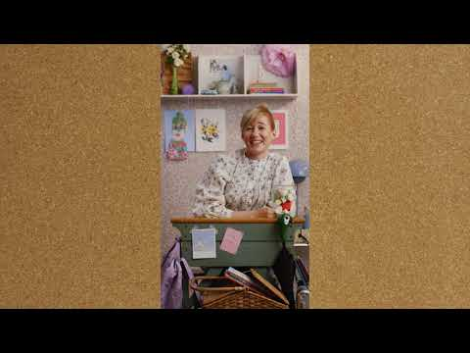

Slide 33
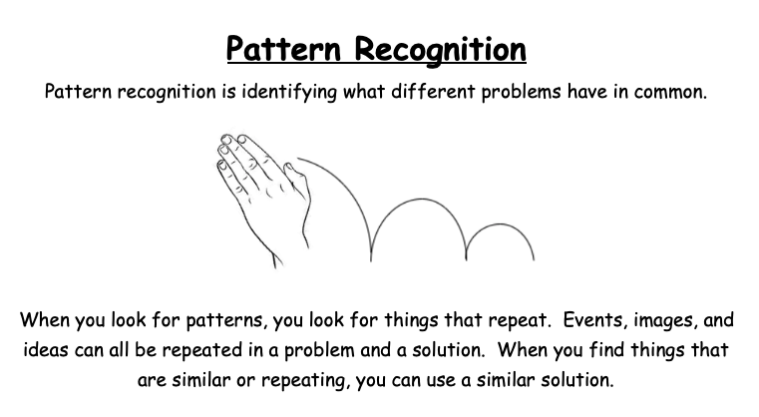

Slide 34
So...how did YOU DO IT?
Share your algorithms.
What patterns do you see?

Slide 35
Post Test
What does decomposition in computer science mean?
How does a computer scientist use abstraction?
Why is pattern recognition important to creating algorithms?

Slide 36

The BIG Picture...
Computational Thinking is the process we use to create a solution to a problem using a computer. It involves decomposing the problem, abstracting important information, creating and testing and debugging algorithms, and recognizing patterns.

Slide 37
Credits
Special thanks to all the people who made and released these awesome resources for free:
Presentation template by SlidesCarnival
Math magic problem created by Math “n” Magic by William M. Futrell, Ph. D.
Block coding resource Scratch created by MIT

