Slide 1

Getting to Know You, CPU
Developed By:
Becky Junge
4th Grade Teacher, Journey Elementary
WySLICE 2022

Slide 2
Lesson Summary
Materials Needed
Students will be introduced to Micro:Bit technology and have the opportunity to program the Micro:Bit to share some personal information about themselves. This activity is intended to be a beginning of the year, get to know you activity, and introduction to Micro:Bit programming.
Micro:Bit (ideally, one per student)
Chromebook/Computer/iPad (ideally, one per student)
Access to Computer/Projector for Modeling/Presentations
Access to https://makecode.microbit.org/

Slide 3
Skills and Concepts
COMPUTER SCIENCE:
5.CS.HS.01 - Model how information is translated, transmitted, and processed in order to follow through hardware and software to accomplish tasks.
5.AP.V.01 - Create programs that use variables to store and modify data.
5.AP.C.01 - Create programs that include sequences, events, loops, and conditionals, both individually and collaboratively.
5.AP.M.02 - Modify, remix, or incorporate portions of an existing program into one’s own work, to develop something new or add more advanced features
5.AP.PD.03 - Test and debug (i.e., identify and fix errors) a program or algorithm to ensure it runs as intended.
ELA:
SL.4.1 - Engage effectively in a range of collaborative discussions (one-on-one, in groups, and teacher-led) with diverse partners, building on others’ ideas and expressing their own clearly.
SL.4.4 - Report on a topic or text, tell a story, or recount an experience in an organized manner, using appropriate facts and relevant, descriptive details to support main ideas or themes; speak clearly at an understandable pace

Slide 4
Lesson Objectives
Students will be able to:
Use the Micro:Bit to write a code to share the following information:
Button A is pressed: Name
Button B is pressed: Favorite Color
Button AB is pressed: Favorite Animal
Work collaboratively to fix or debug their code.
Make a short presentation, introducing themselves to the class.

Slide 5

To Get Us Started…
Without your voice… tell the person next to you what your favorite color is.

Slide 6
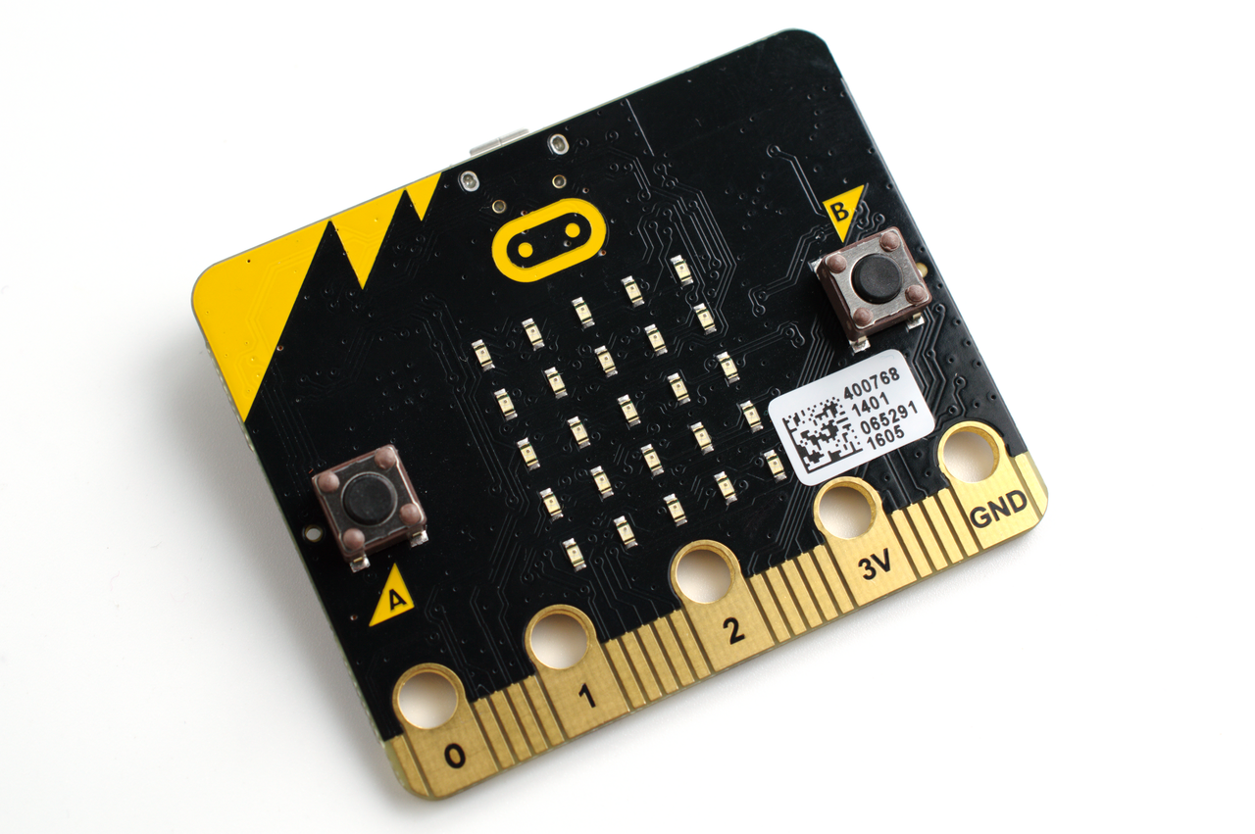
Today, you are going to use a Micro:Bit to introduce yourself and share some things about you!

Slide 7
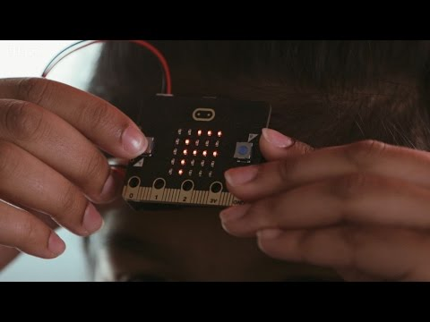
What is a Micro:Bit?

Slide 8
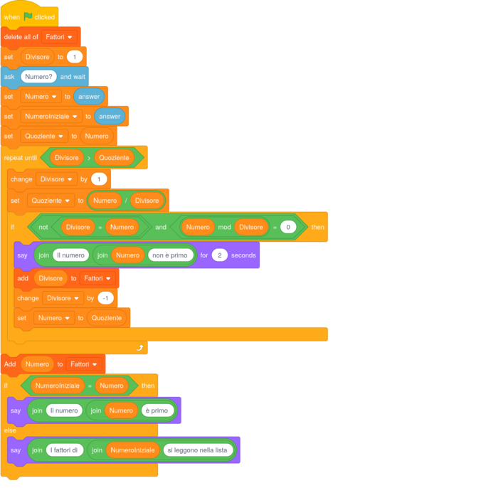
How does it work?
https://makecode.microbit.org

Slide 9
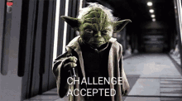
Your Challenge:
Write a program that completes the following tasks:
Press Button A: Show name
Press Button B: Show favorite color
Press Button AB: Show favorite animal

Slide 10

Getting to Know You!
Use your Micro:Bit to
introduce yourself to
your partner.
Partner A: Ask Question
Partner B: Answer showing MicroBit Screen
Switch roles until you have asked and answered all 3 questions.

Slide 11
Reflections:
-What worked well?
-What was frustrating?
-Did you fix any problems along the way?
-How might a programmed device to communicate be helpful in everyday life?

