Slide 1
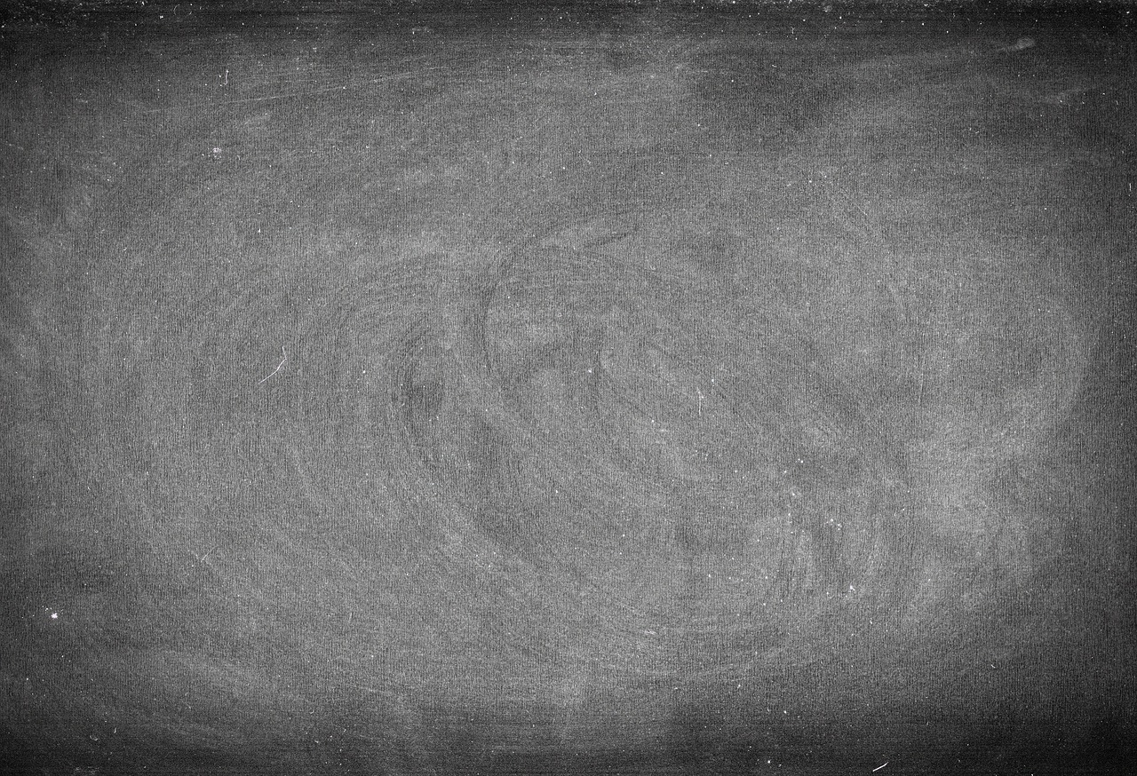

aMAZEing
Margaret
Hamilton
Kalista Pendleton
Gifted & Talented WY-Slice

Slide 2
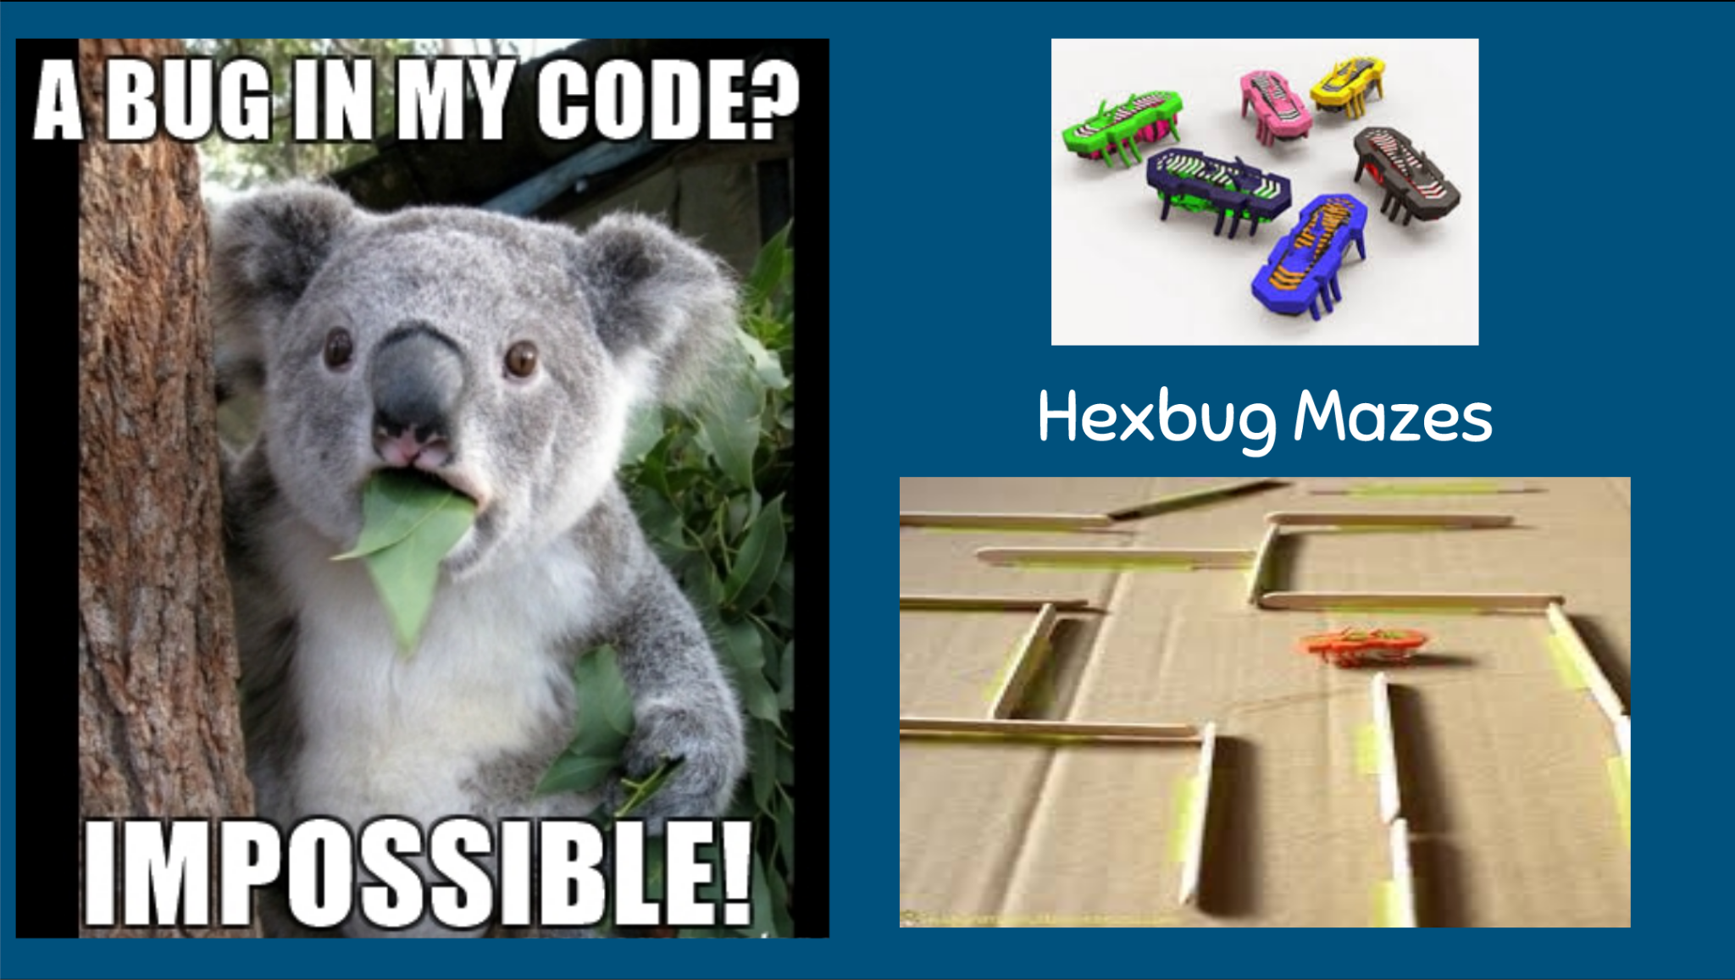

Slide 3
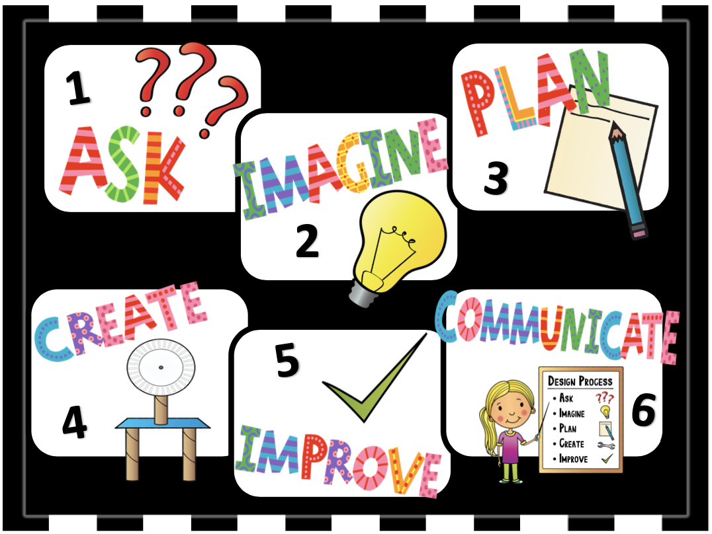
The Engineering Design Process

Slide 4

How can I create a maze for a bug to successfully make it from the computer to the trash?
Define the constraints

Slide 5
Supplies and Constraints:
You and your team will have three feet of tape and may choose one of the following materials to make your maze:
Straws
Popsicle Sticks
Cardboard Rolls
Base 10 Sticks
Keva Planks
It must have at least 5 different twists and turns like a MAZE!
You CANNOT just make a straight path forward!

Slide 6
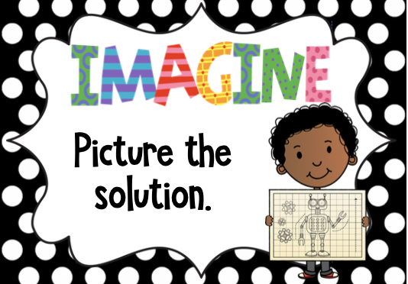

Slide 7
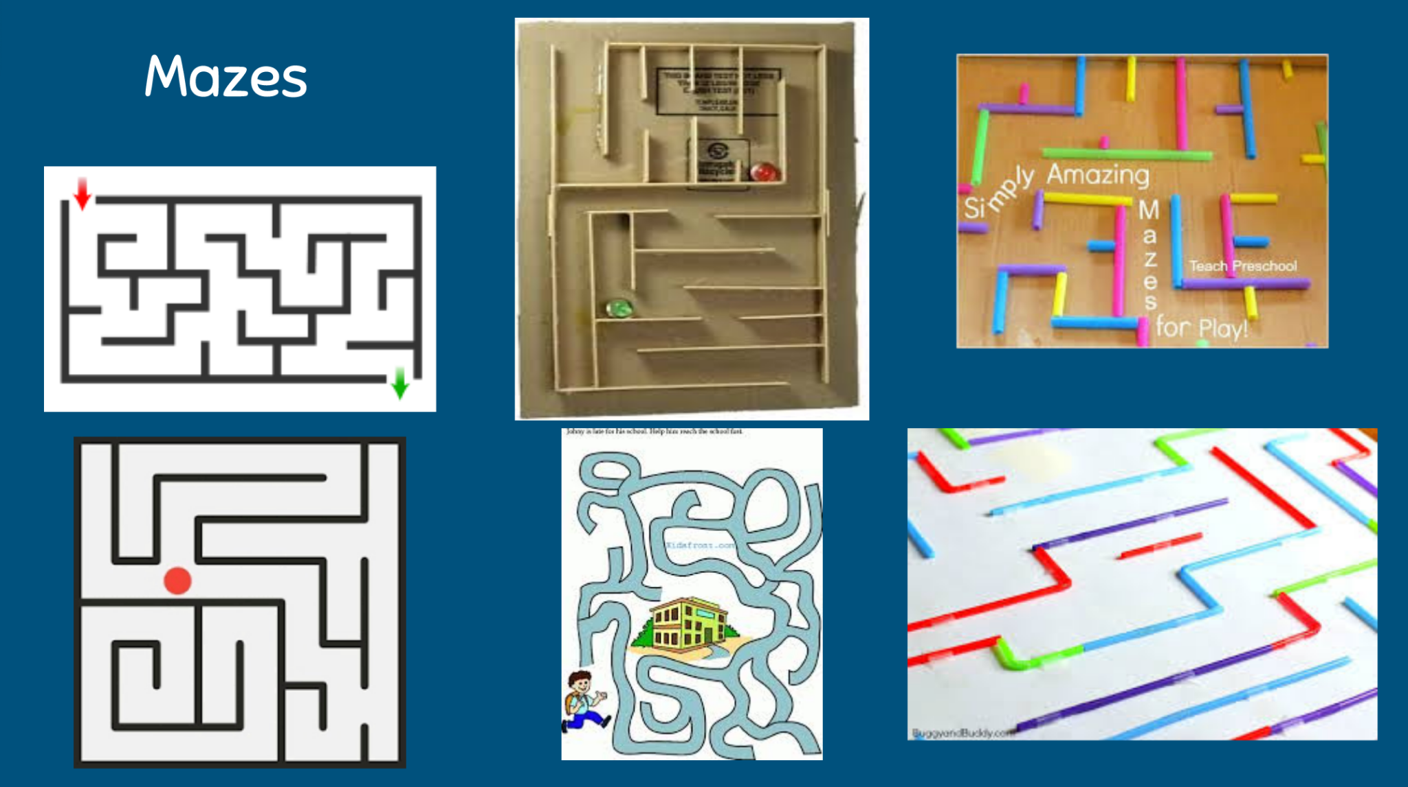

Slide 8


Work with your team to come up with a plan for your maze.
What materials will you use?
Who will do what jobs?

Slide 9
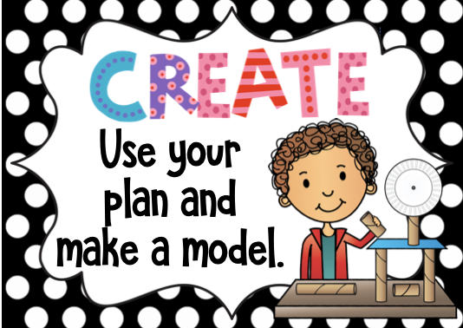


Slide 10


What worked well?
What were some challenges?
What did you do or could you do to improve your maze?

Slide 11

Let’s take a Gallery
Walk!

