Slide 1


Kindergarten Computer Scientists
Lessons adapted from Computer Science for all in San Francisco, CSinSF.org
Algorithms & Programming
Impacts of Computing
2.AP.A.01, 2.AP.C.01, 2.AP.M.01, 2.AP.PD.04, 2.IC.C.01
Small but mighty problem solvers!
#1
#2
#3
#4
#5
#6

Slide 2
What is a computer?
What is computer science?
#1

Slide 3



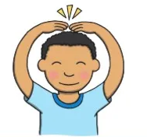

Computer Science
Computer science is
using the power of computers
to solve our problems
and express ourselves!

Slide 4
WHAT IS A COMPUTER?

Slide 5
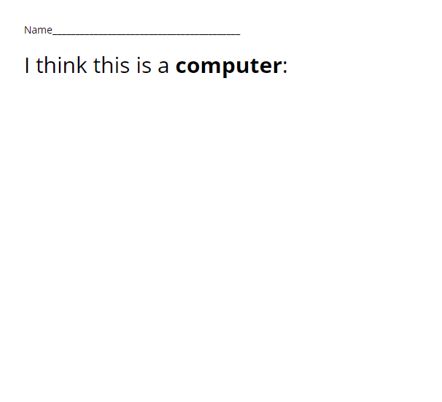
What is a computer?

Slide 6
Look at your computer...
How does your computer work? Do you press buttons or talk to it?
Does it solve a problem for someone?
Can we express our feelings or ideas using your computer?

Slide 7
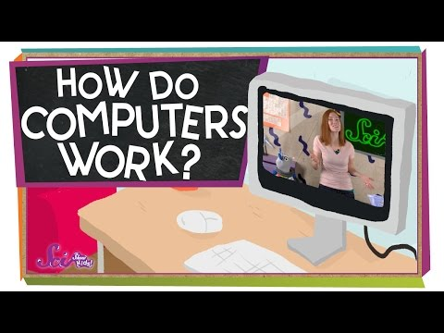
A little more information...

Slide 8
Next...
We are going to learn two new words:
INPUT
OUTPUT
Home

Slide 9
That Could Be A Computer!
Learning Input and Output
#2

Slide 10


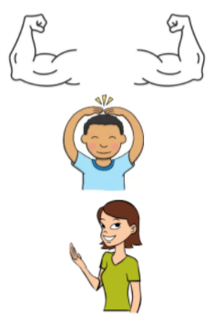
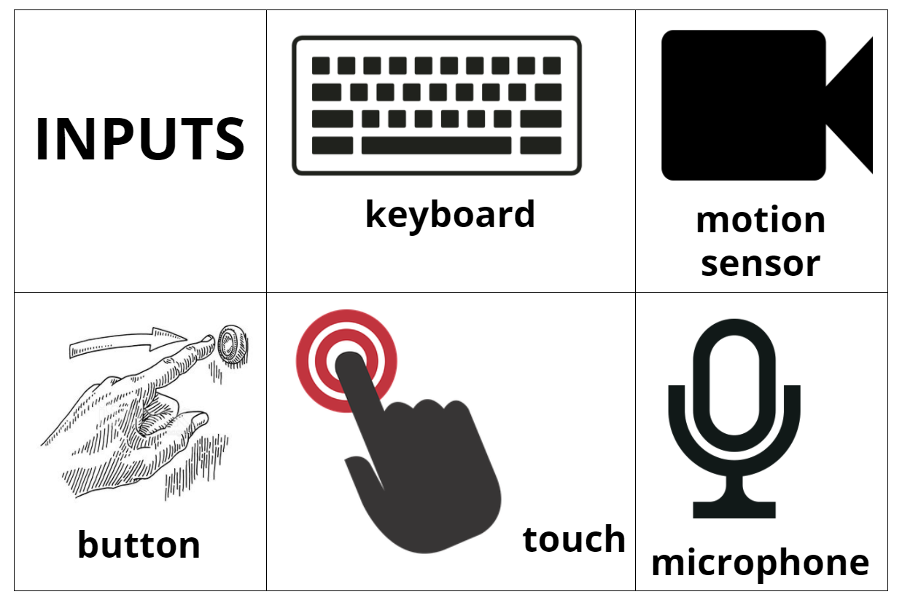


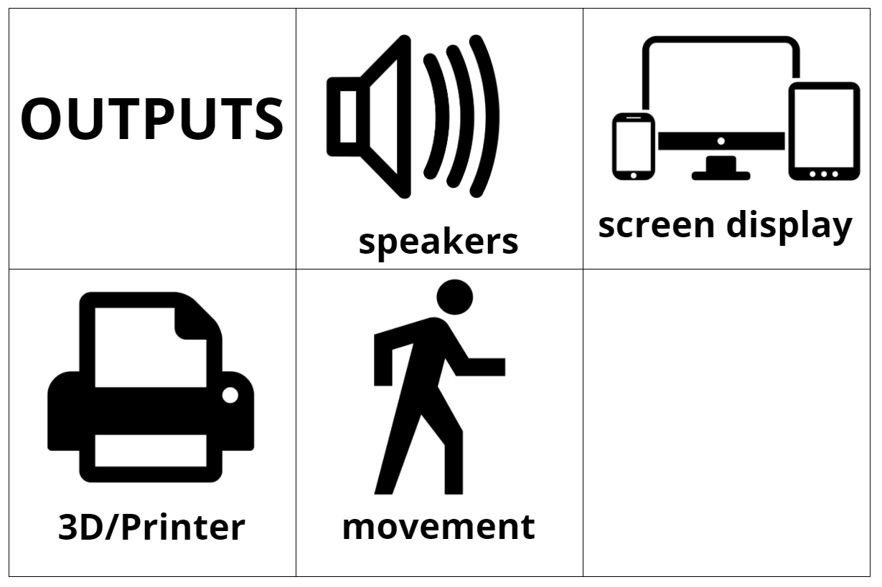
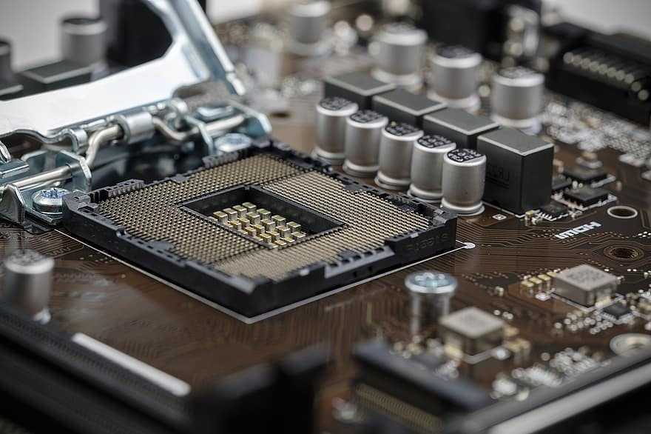

Big FANCY words...
Computer Science
Hardware

Slide 11
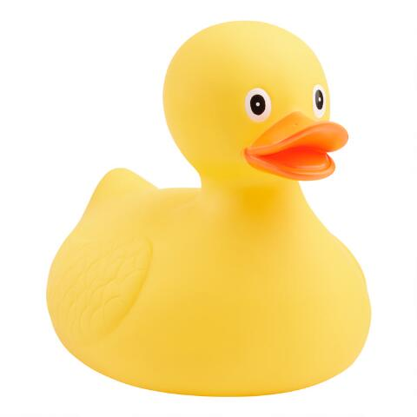
Is this a computer?
It could be...

Slide 12

Let’s play:
This is not a __________, it’s a computer that _______________________.
The input is ____________.
The output is _____________.

Slide 13
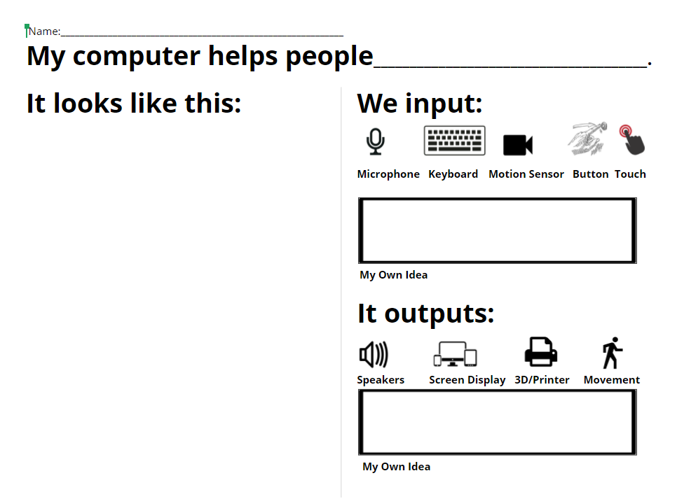
Try it yourself...

Slide 14
Next...
In our next lesson, we’re going to be thinking like a computer by
SEQUENCING
Home

Slide 15
Secret Handshake Sequencing
What is a sequence?
#3

Slide 16

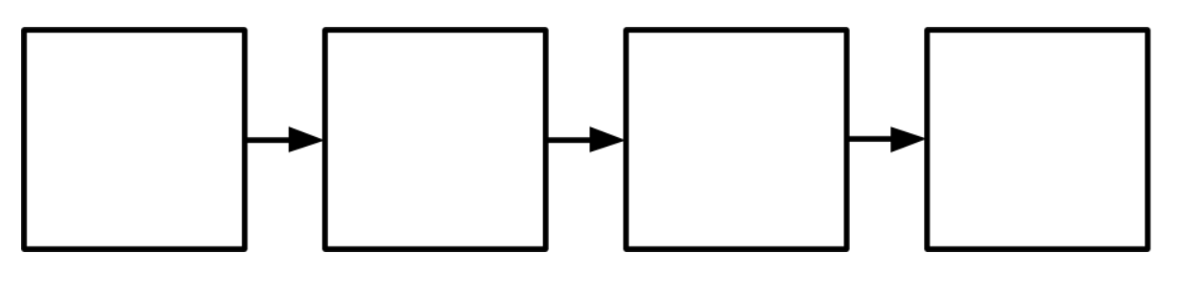
Big fancy words...
Computer Science
Sequence

Slide 17

A cool way to say hello!

Slide 18

What order did they teach us the moves?

Slide 19
What order did they do the secret handshake?

Slide 20
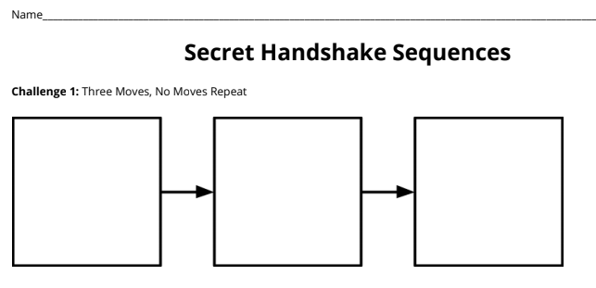
Challenge 1: Make a sequence using our three moves in any order you want.

Slide 21
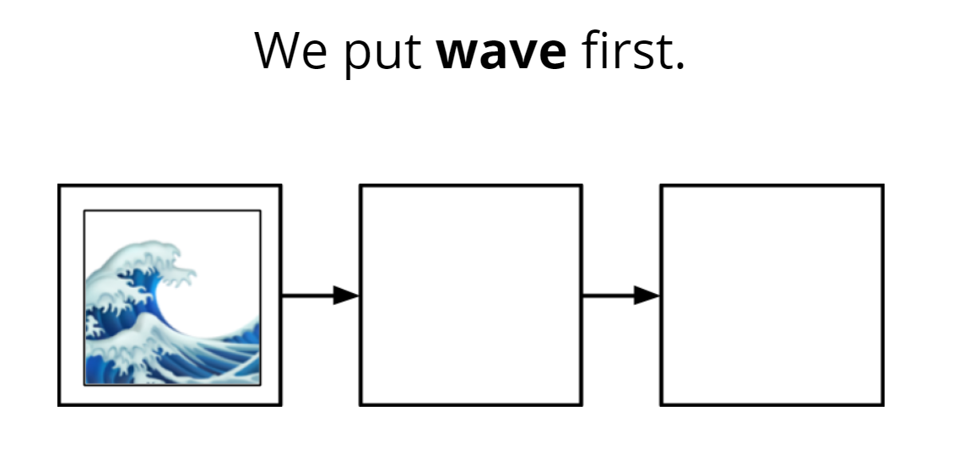
Stand up if...

Slide 22
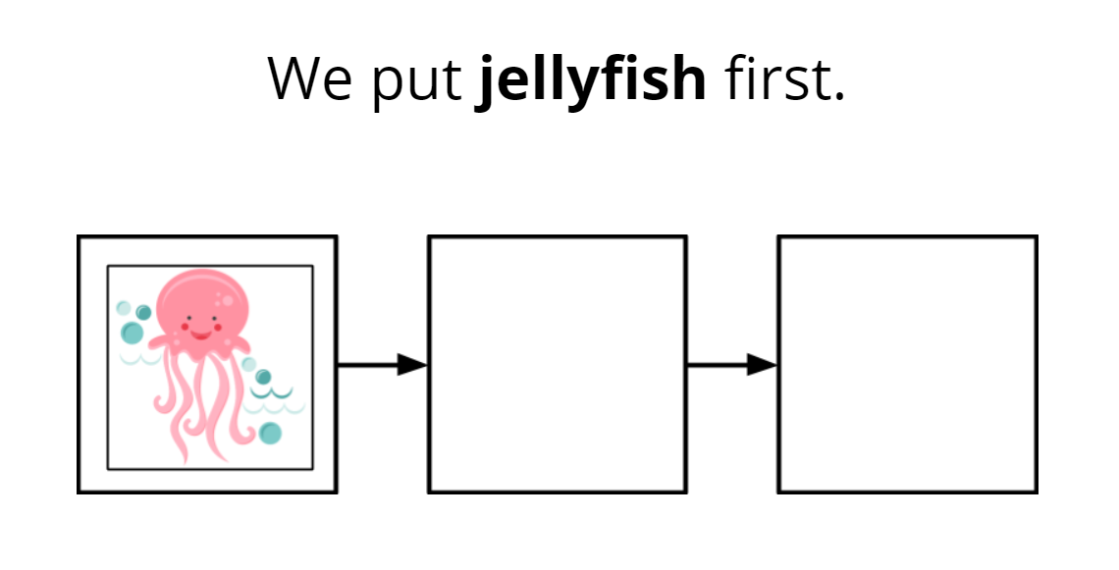
Stand up if...

Slide 23
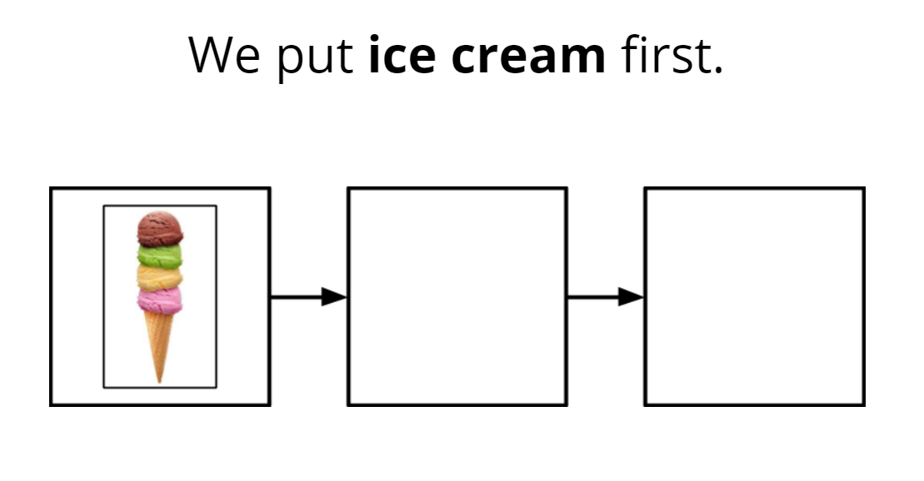
Stand up if...

Slide 24
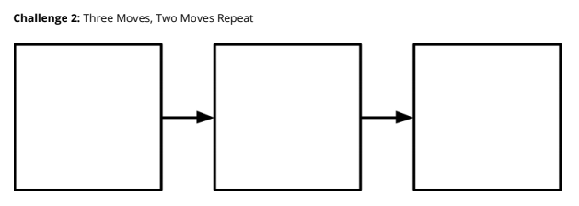
Challege 2 - SPICY - Make a sequence that uses only two moves but you do one twice.

Slide 25
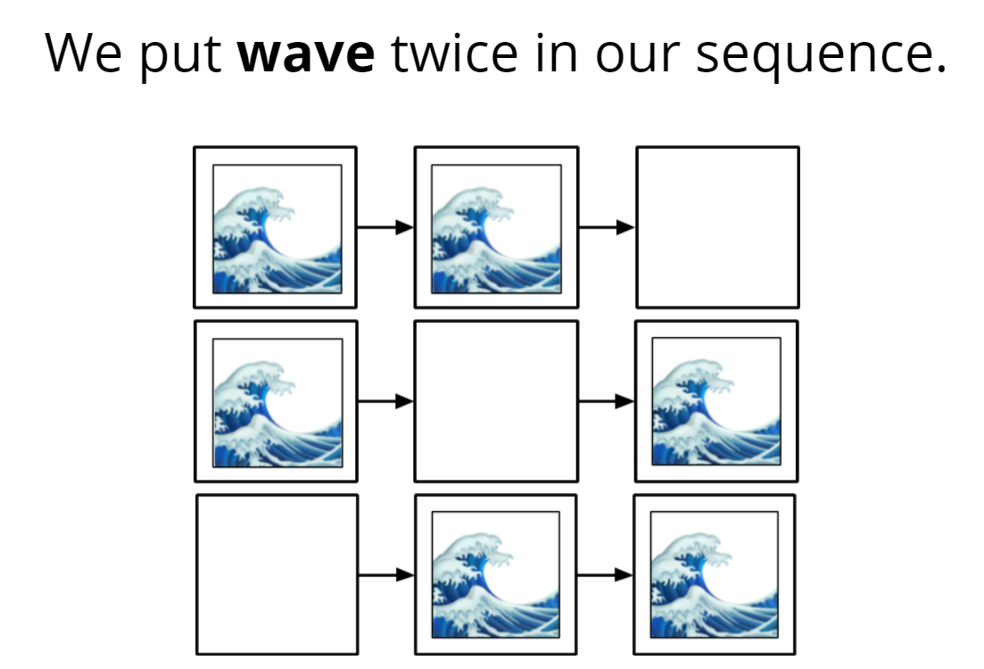
Stand up if...

Slide 26
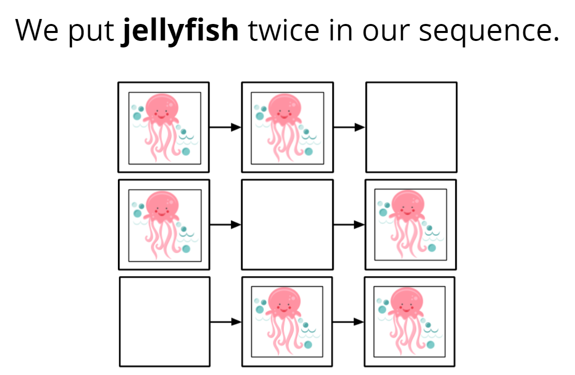
Stand up if...

Slide 27
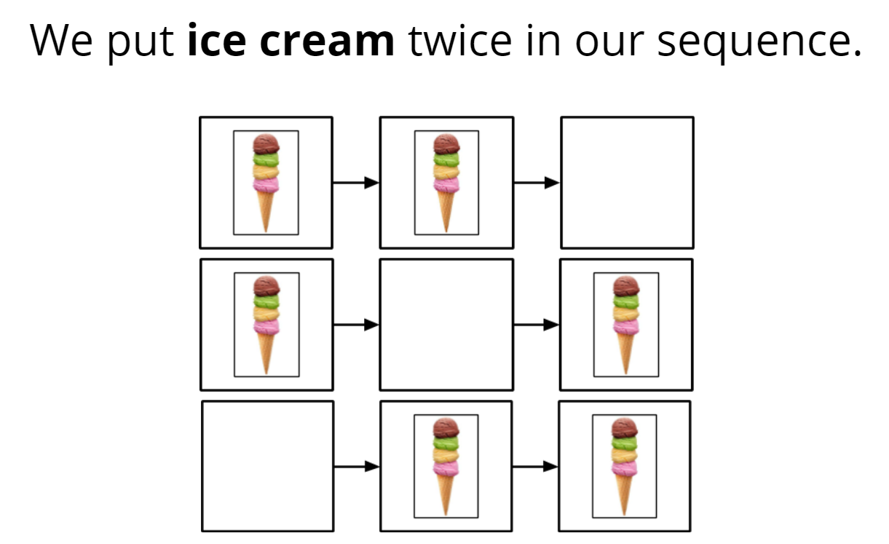
Stand up if...

Slide 28
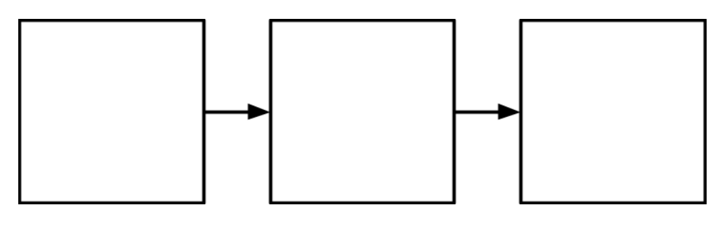
Challenge 3 - SPICIER - Pick two images to glue onto your sequence, then draw your own image.

Slide 29
Challenge 4 - SPICIEST - Make up FOUR of your very own moves for your sequence.

Slide 30

Just for fun!

Slide 31
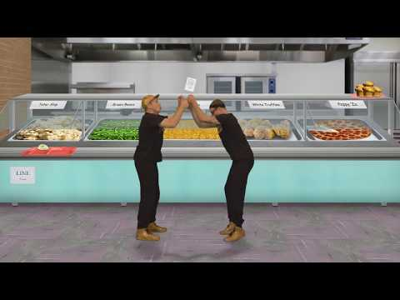
Try this...

Slide 32
Next...
We are going to do more thinking like a computer by looking for
PATTERNS
Home

Slide 33
Thinking with Patterns
Visually solve problems like a computer
#4

Slide 34
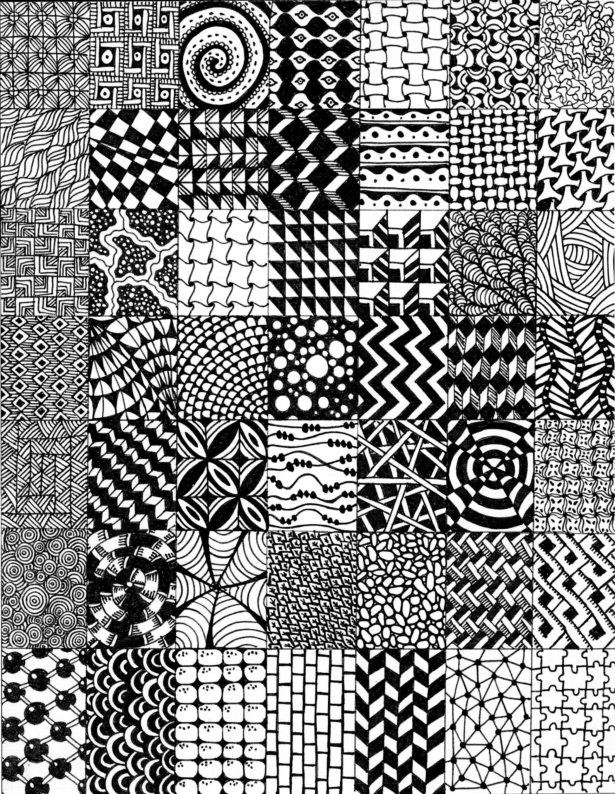


Big FANCY words!
Computer Science
Pattern
Parts that repeat

Slide 35
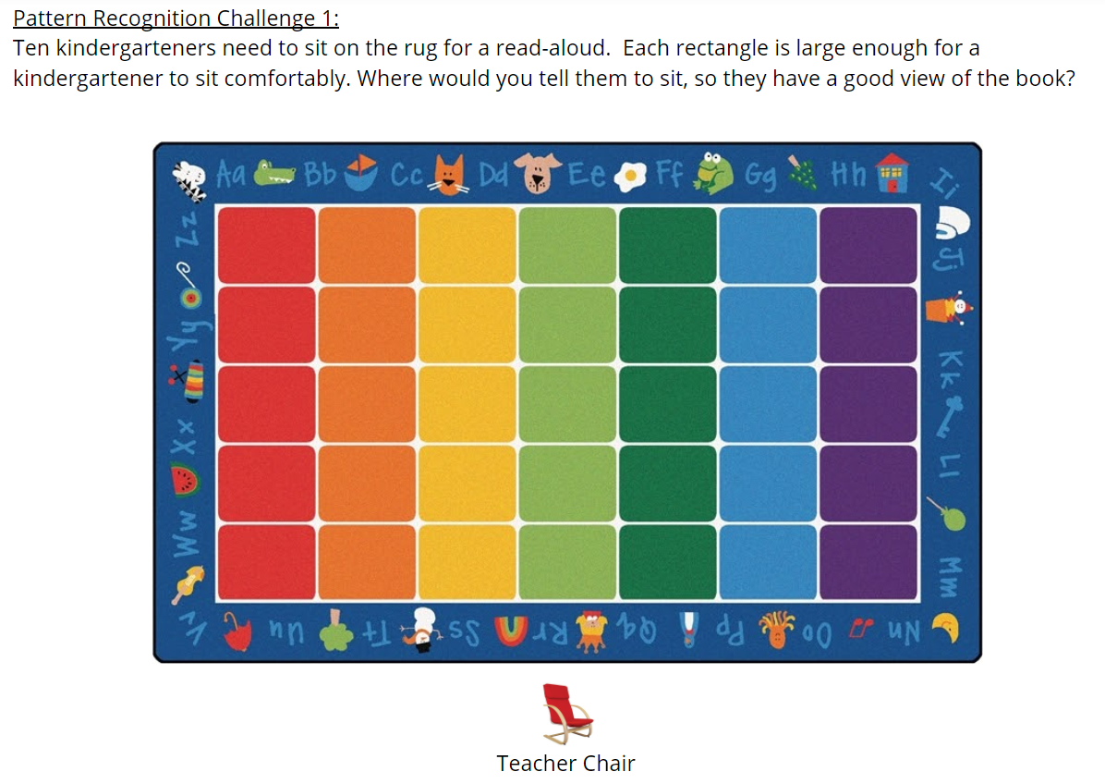

Slide 36
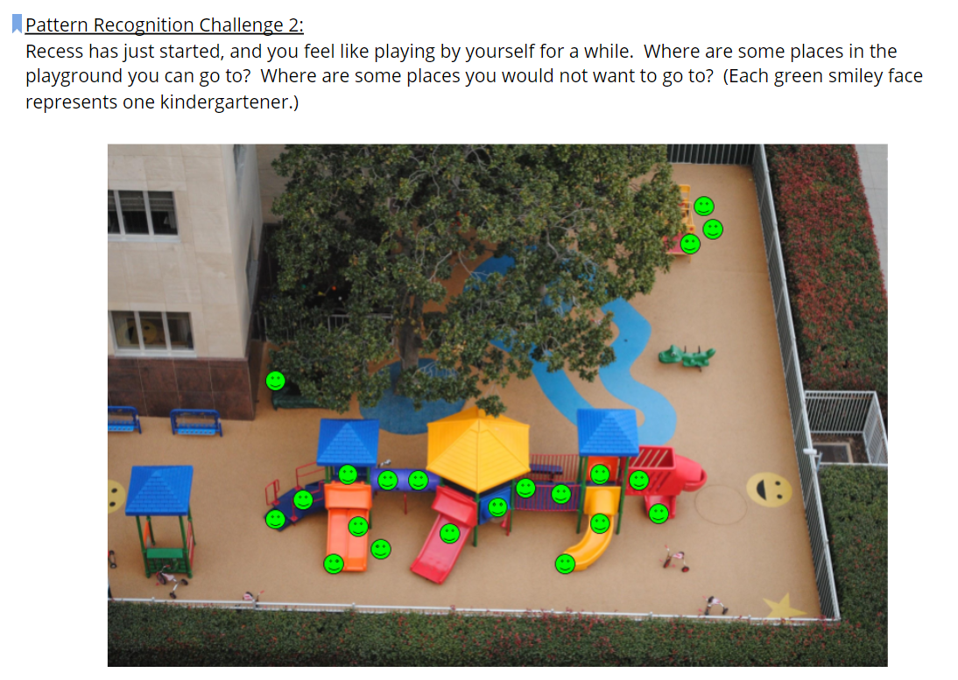

Slide 37
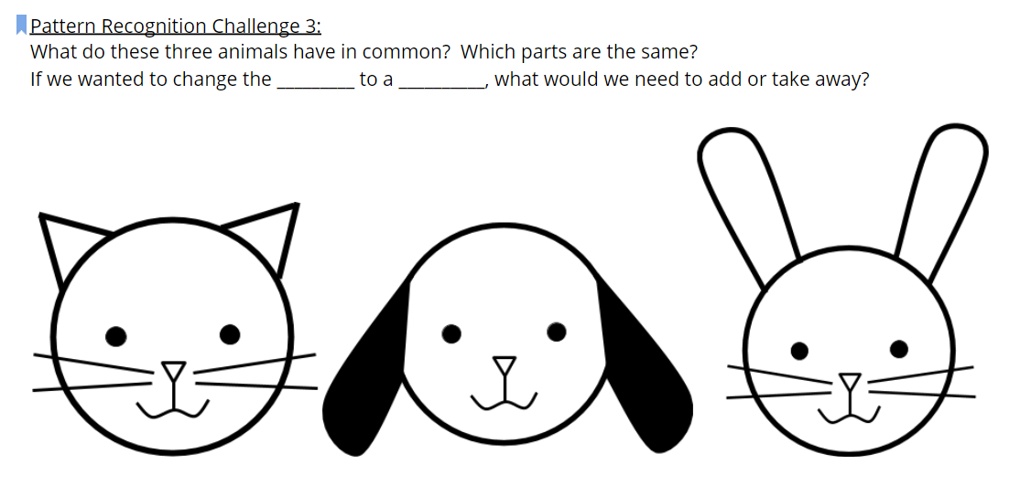
Challenge 3 - SPICY!

Slide 38
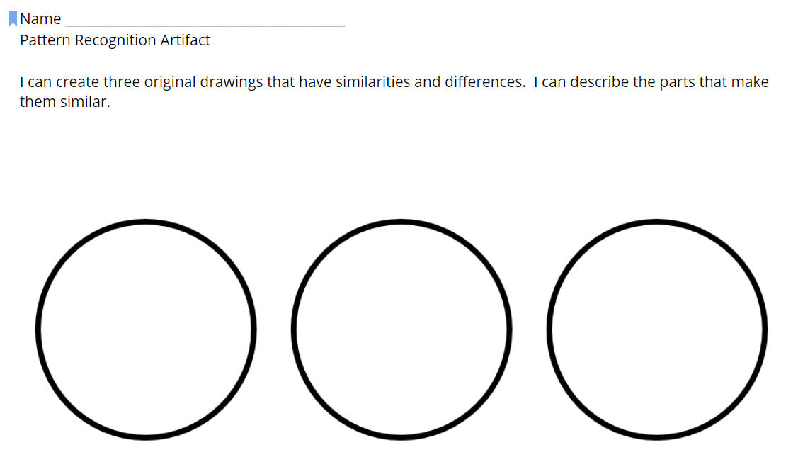
Challenge 4 - SPICIER!
Draw one thing that is the same on each circle.
Draw one thing that is the same on two circles and a different thing on the other circle.
Draw something different on each circle.
Decorate outside of your circles.

Slide 39
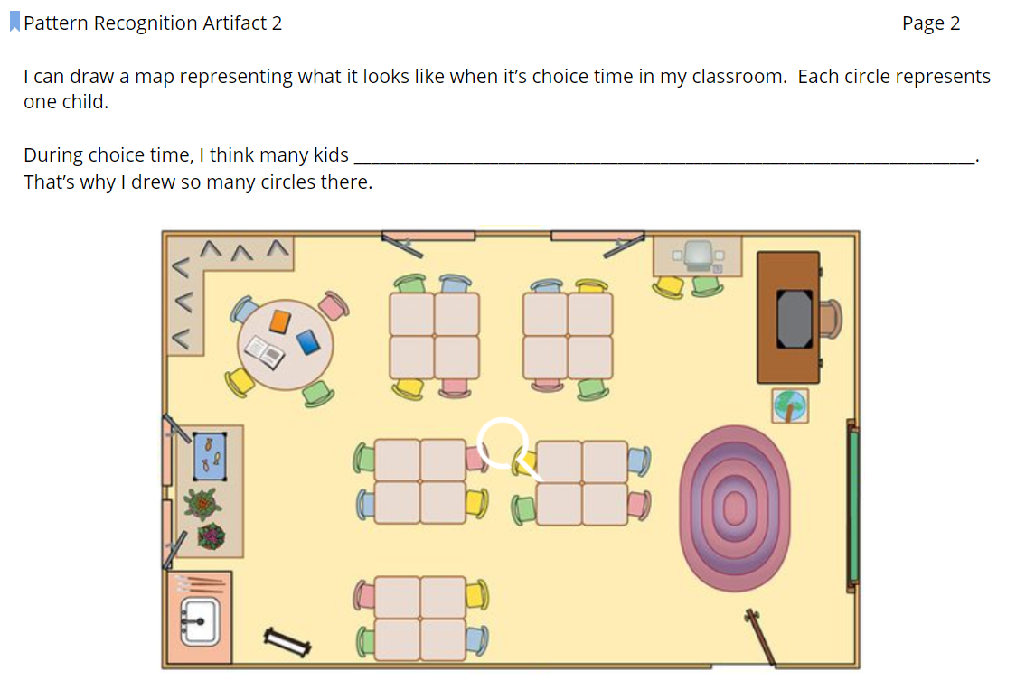
Challenge 5 - SPICIEST!

Slide 40
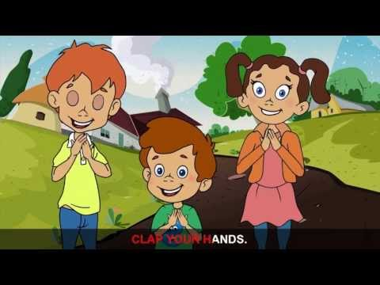
Listen for patterns

Slide 41

Listen, look, and move for patterns

Slide 42
Next...
We are going to think like a computer by breaking down a program into smaller pieces. We will be using the words
DECOMPOSE
MODULARITY
Home

Slide 43
Break it down!
Looking at smaller parts of the big picture...
#5

Slide 44


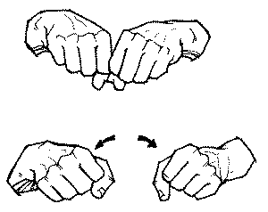
Big FANCY Words
Computer Science
modularity
decompose

Slide 45
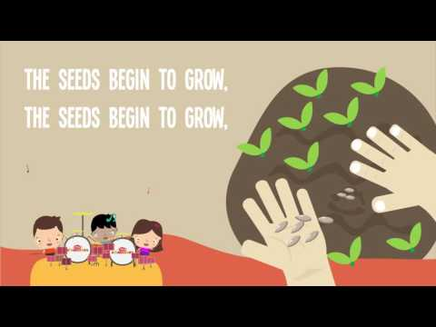
Listen for the parts...

Slide 46


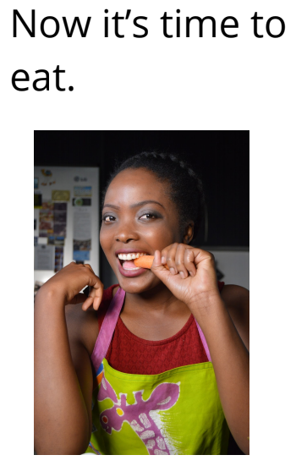
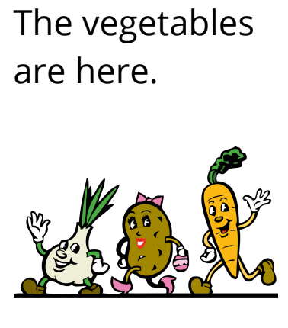

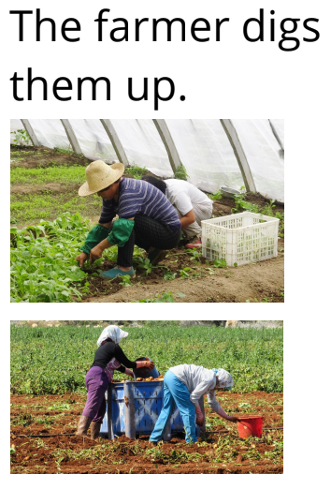

Now put the parts together...

Slide 47
Let’s try it...
We’re going to watch an awesome robot dance. The computer scientist didn’t tell us the part of the dance so we are going to have to BREAK IT DOWN! Look for the small parts and after we watch it we will put it back together.

Slide 48
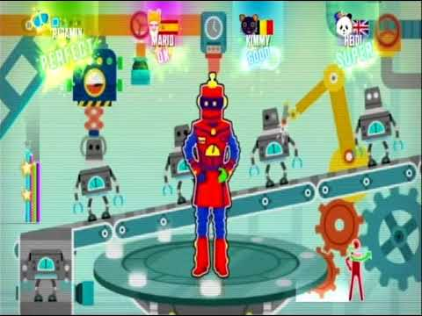

Slide 49
Your turn...
I am going to give you a bunch of small pieces. You need to put them together to make a robot.

Slide 50

While you work listen for the smaller parts that repeat...

Slide 51
Next...
We are going to work on two new ideas:
ALGORITHM
PERSERVERANCE
Home

Slide 52
Nevertheless, they Persevered
Learning about algorithms and perseverance
#6

Slide 53


Big FANCY words
Computer Science
perseverance
algorithm
Trying again and again even when something is very hard.
Going step by step in the right order to finish a job.

Slide 54
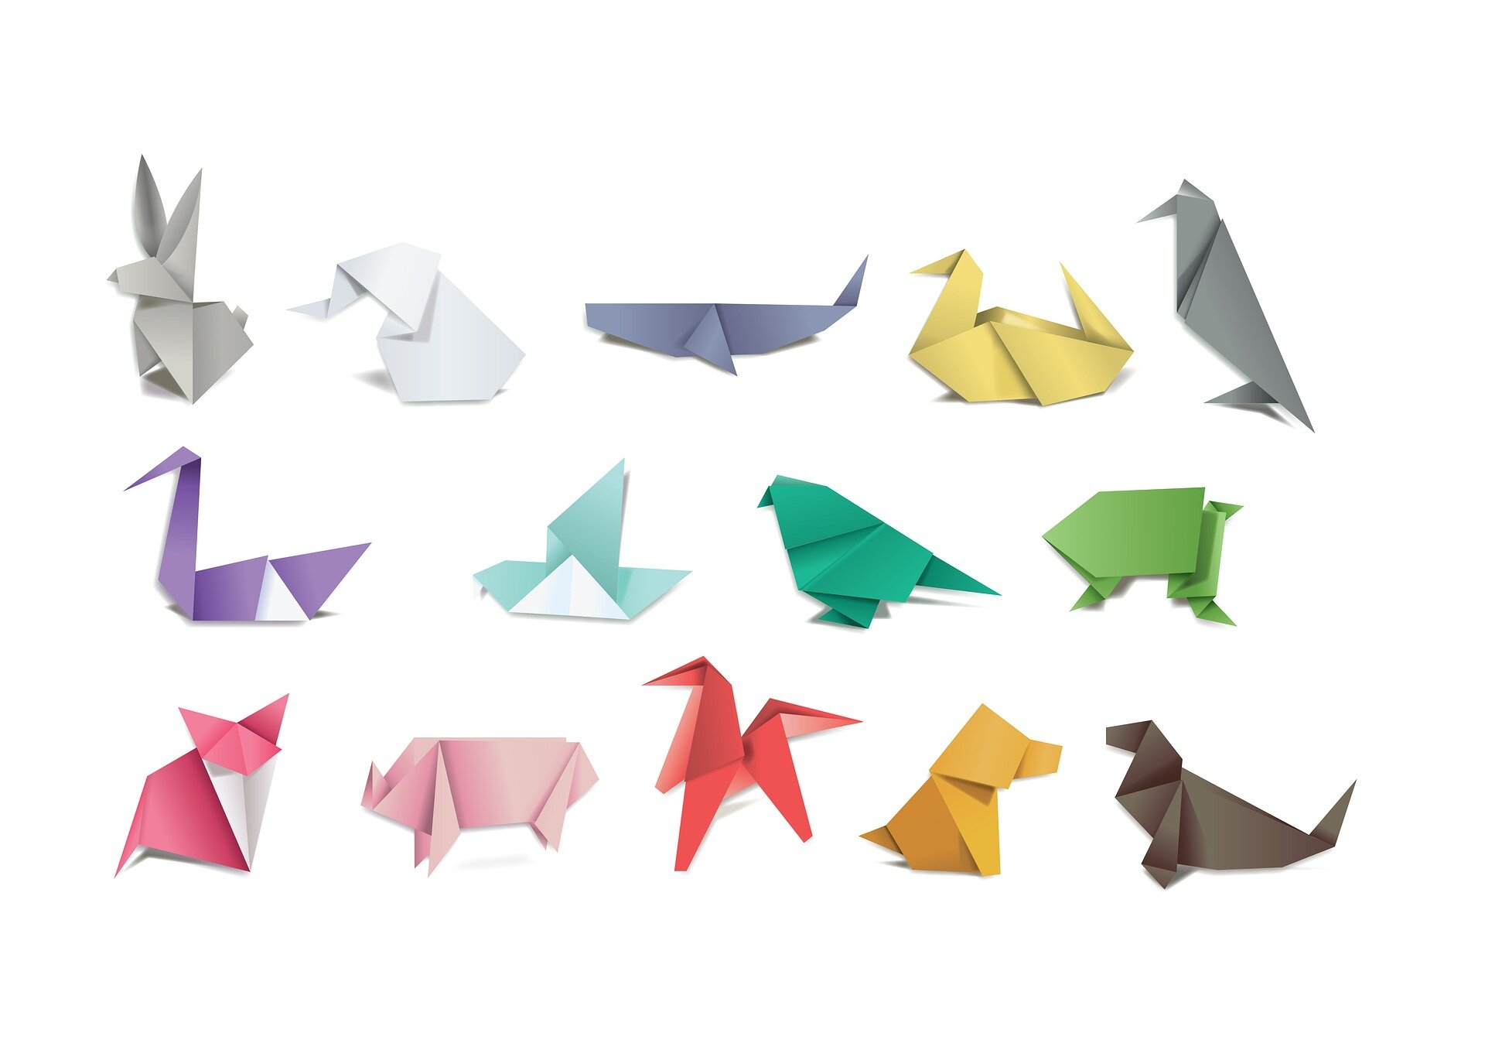
What is this special art?

Slide 55
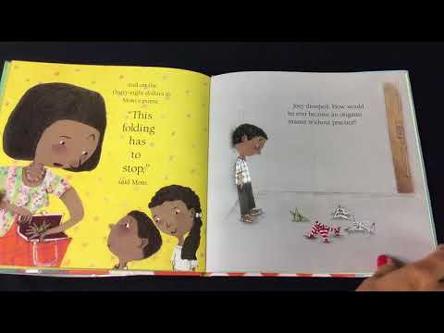
Joey has perseverance just like you!

Slide 56
Algorithms
Computers follow directions called ALGORITHMS.
You are going to be a computer today and follow algorithms.
Your algorithms will be the steps to make origami.
You will choose one algorithm to follow...

Slide 57
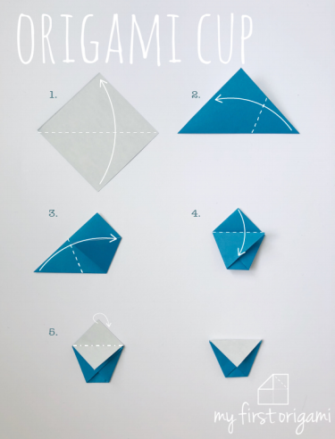
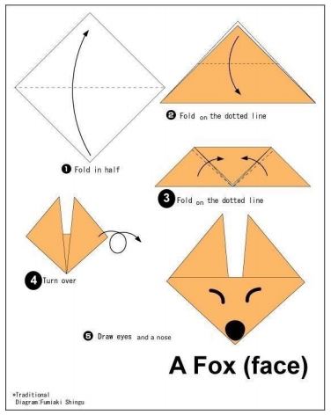
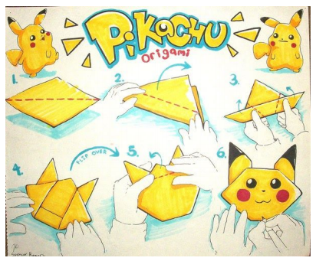
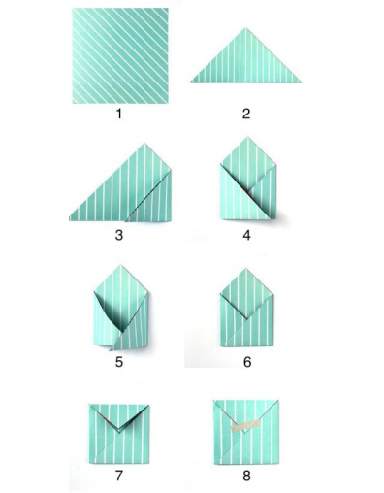
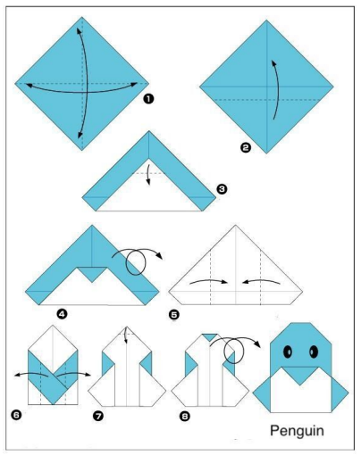
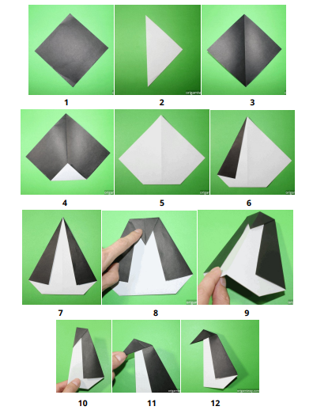
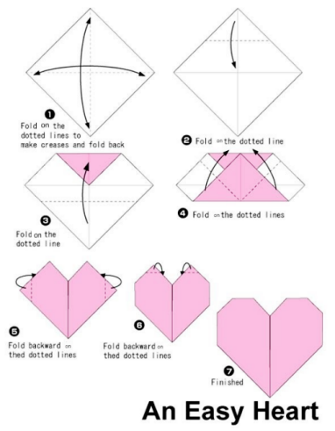
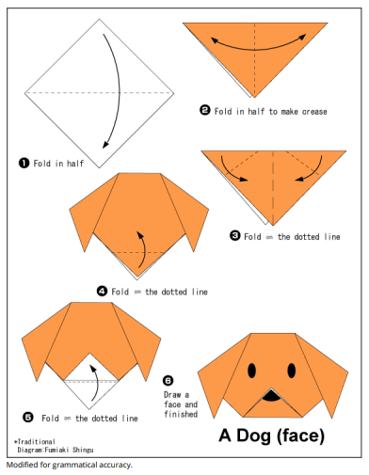

Slide 58

Remember
It will be challenging!
You will need to show PERSEVERANCE.
PERSEVERANCE is trying again and again even if something is very hard.

Slide 59
Let’s share!
I tried to make a ________________.
It was very challenging.
I had to show PERSEVERANCE!

