Slide 1
Thinking with Patterns
Visually solve problems like a computer
#4

Slide 2

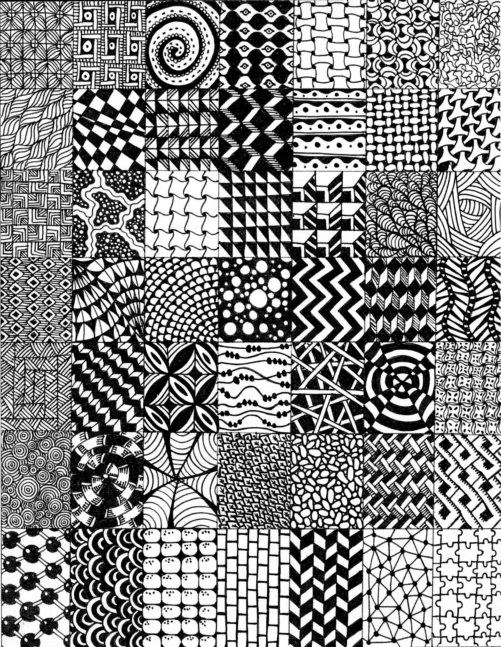

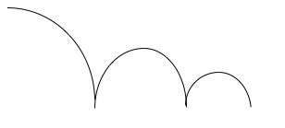
Big FANCY words!
Computer Science
Pattern
Parts that repeat

Slide 3
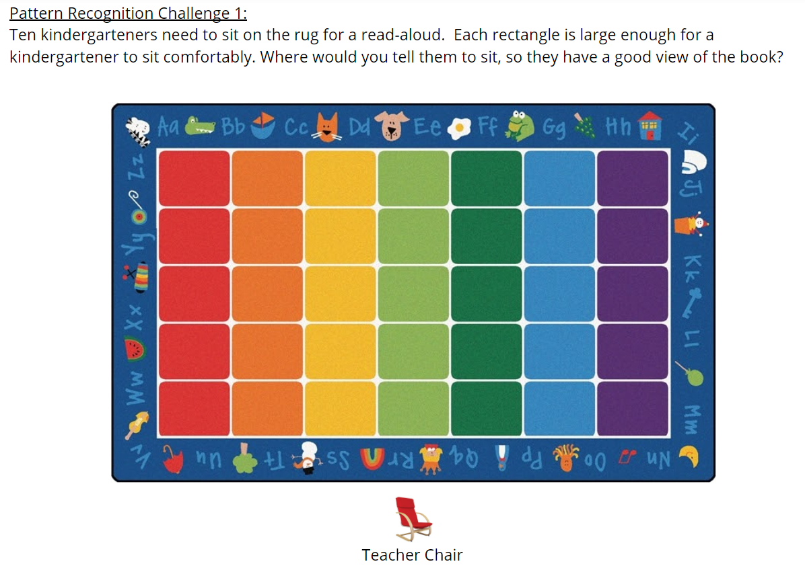

Slide 4
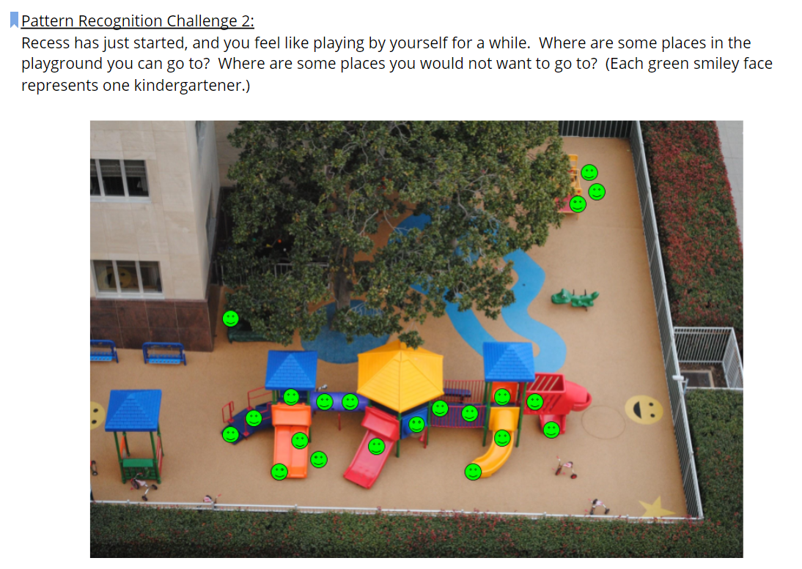

Slide 5
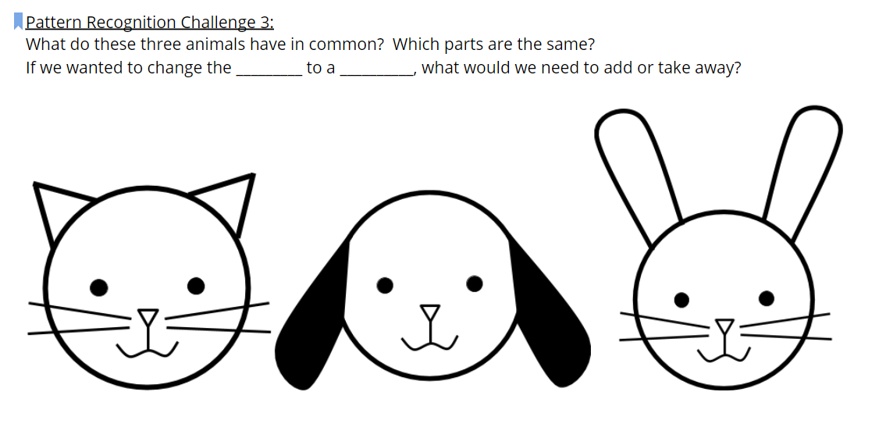
Challenge 3 - SPICY!

Slide 6
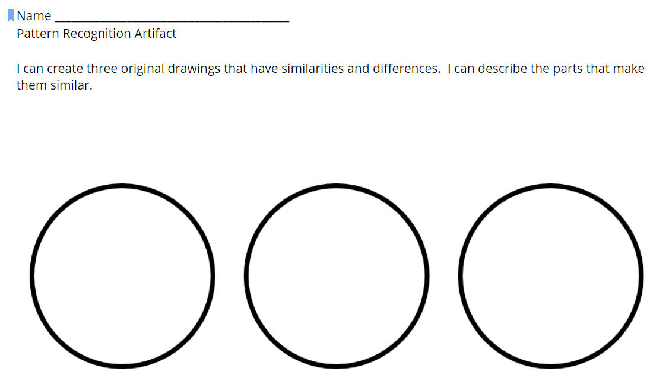
Challenge 4 - SPICIER!
Draw one thing that is the same on each circle.
Draw one thing that is the same on two circles and a different thing on the other circle.
Draw something different on each circle.
Decorate outside of your circles.

Slide 7
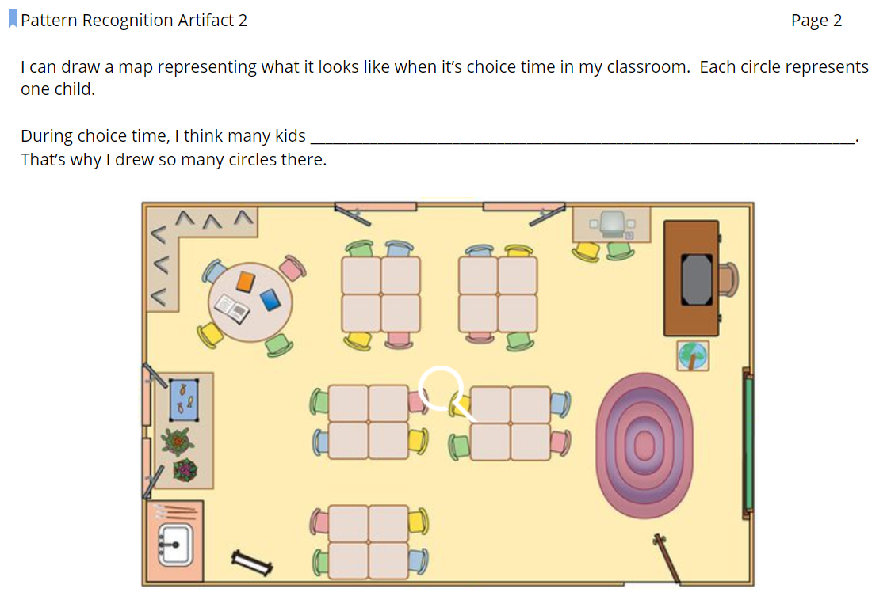
Challenge 5 - SPICIEST!

Slide 8

Listen for patterns

Slide 9

Listen, look, and move for patterns

Slide 10
Next...
We are going to think like a computer by breaking down a program into smaller pieces. We will be using the words
DECOMPOSE
MODULARITY
Home

Slide 11

Free templates for all your presentation needs
For PowerPoint and Google Slides
100% free for personal or commercial use
Ready to use, professional and customizable
Blow your audience away with attractive visuals

