Slide 1
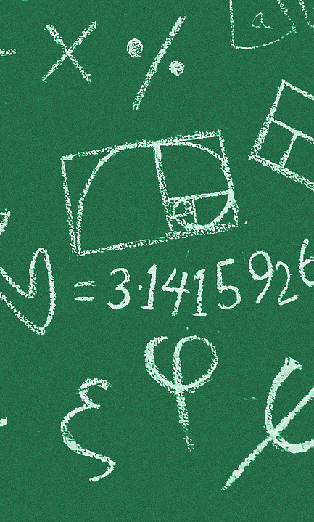
See ya Later, Alligator: Coding and Ratio Tables
Designed to be a companion/extension to Bridges in Mathematics Unit 2 Module 2, Session 4 Lesson: Build Ratio Tables.
Developed by:
Becky Junge
4th Grade Teacher, Journey Elementary
WySLICE 2022

Slide 2
Lesson Summary
Materials Needed
Students will work in pairs to build ratio tables defining a list of data for distance traveled by various animals over time based on their speed. Students will design a formula for their assigned ratio table and then program a Micro:Bit to quickly calculate the output data and record it in their Google Sheet. Then, students will discuss the efficiency of solving the problem and be introduced to the Google Sheets formula to validate their data.
Computer/Projector for Teacher Modeling
Access to Ratio Tables Google Sheet
Chromebook
Access to https://makecode.microbit.org/
Building Ratio Tables Handout

Slide 3
Skills & Concepts
COMPUTER SCIENCE
5.AP.V.01 - Using grade appropriate content and complexity, create programs that use variables to store and modify data
5.AP.M.O1 - Using grade appropriate content and complexity, decompose (break down) problems into smaller, manageable sub-problems to facilitate the program development process
5.AP.PD.03 - Using grade appropriate content and complexity, test and debug a program or algorithm to ensure it runs as intended.
5.DA.IM.01 - Use data to highlight or purpose relationships, predict outcomes, or communicate an idea.
5.IC.C.02 - Develop, test, and refine digital artifacts or devices to improve accessibility and usability for diverse end users
MATH
4.OA.4 - Demonstrate an understanding that a whole number is a multiple of each of its factors
4.NBT.4 - Add multi-digit whole numbers
4.NBT.5 - Multiply a 2-digit whole number by a 1-digit whole number and two 2-digit numbers using strategies based on place value and the properties of operations
4.MP.1 - Make sense of problems and persevere in solving them
4.MP.6 - Attend to precision

Slide 4
Lesson Objectives
Students will be able to…
Build a ratio table to display a set of data using a Google Sheet.
Identify and solve a multiplication formula to more efficiently solve the problem.
Write a code for the Micro:Bit to calculate the outputs of the ratio table and troubleshoot for its validity.
Discuss the impact that technology can have to efficiently solve a problem.

Slide 5
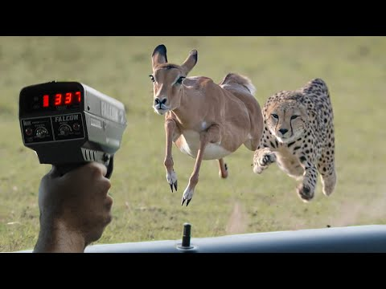

Slide 6
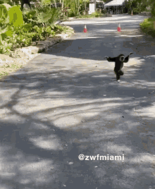
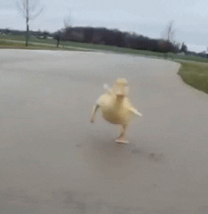
Problem:
How can we form a data set to calculate how far an animal can travel over time?

Slide 7
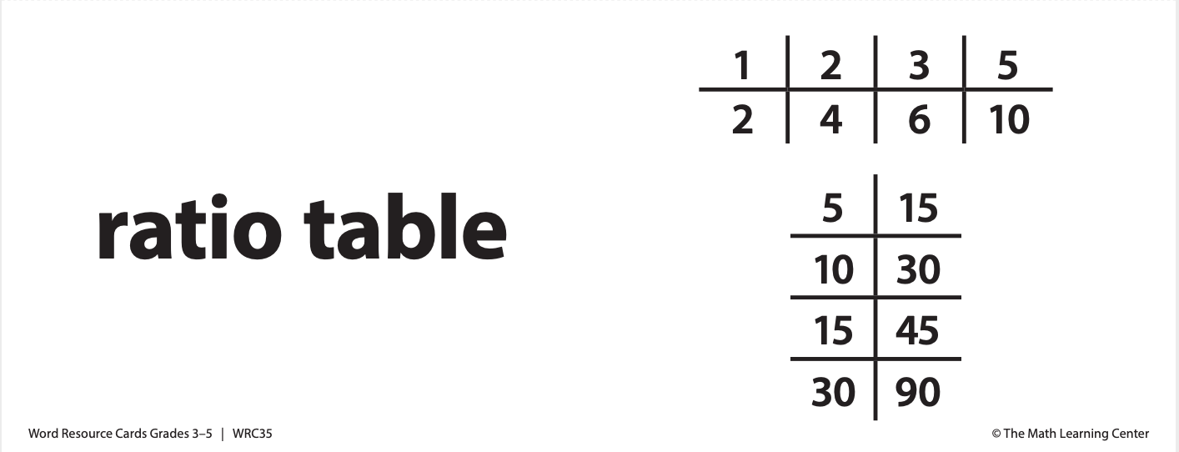
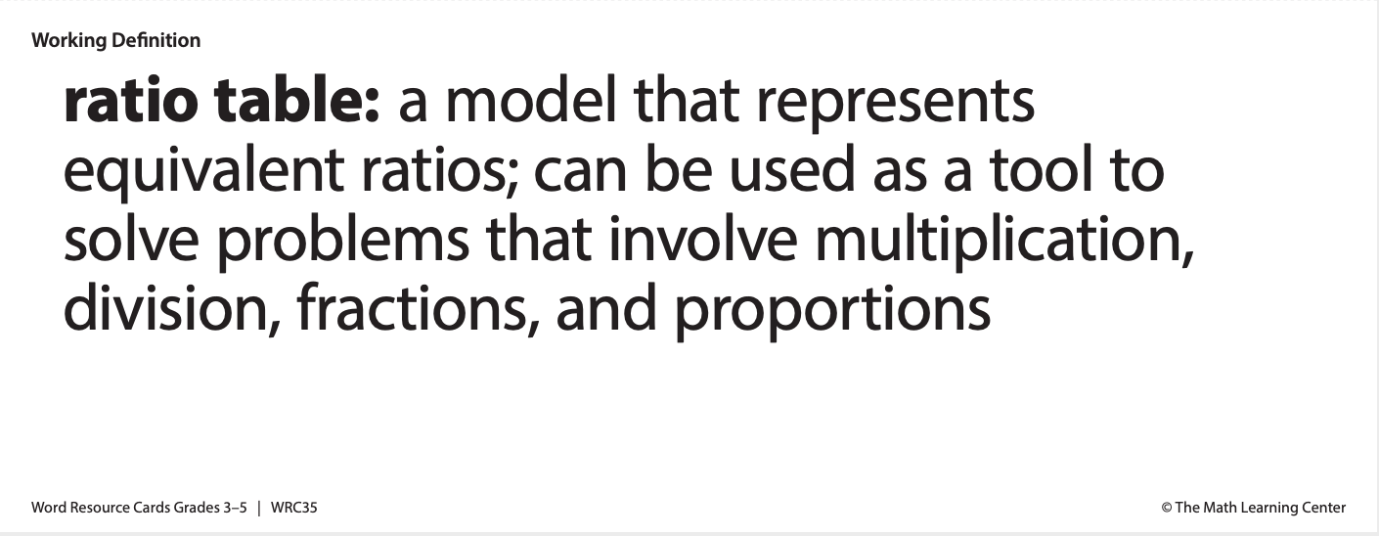
Today you are going to work in pairs to construct a ratio table to see how far an animal can travel after 30 hours.

Slide 8

See ya later, Alligator!
Alligators can run 10 mph.
How far can an alligator
travel in 30 hours?

Slide 9
How can we use a ratio table to solve this problem?
Think… What do the numbers represent?
 | 1
 | 10

Slide 10

Now it’s your turn to try! Work with your partner to fill in cells 1 through 15 on your ratio table.
Look for patterns. What do you notice? How can you tell if you made an error?

Slide 11

Is there a more efficient way we can solve this problem?

Slide 12

Let’s Get Coding!
Go to https://makecode.microbit.org and write a code that turns your Micro:Bit into a calculator. Use your Micro:Bit program to help you fill in the rest of your ratio table.
Remember! Think through what steps your Micro:Bit needs to follow to complete the task. Work with your partner to troubleshoot and debug your program if it does not work!

Slide 13

Let’s Reflect:
What was the most efficient way to solve your problem? Why?
Did the technology improve your ability to do the task? Explain your thinking.

